Slide 1
Lecture 3
Two Classification Models:
k-Nearest Neighbors (kNN)
and
Naive Bayes

Slide 2
Classification
Classification is the problem of identifying to which set of classes a new observation (or instance) belongs on the basis of a training data set containing observations (or instances) whose class membership is known.
In general, the goal of classification is to learn a mapping from inputs x (data instances) to outputs y (classes), where y ∈ {C₁, . . . ,C_{N}}, with N being the number of classes. If N= 2, this is called binary classification; if N > 2, this is called multiclass classification. If the class labels are not mutually exclusive (e.g., somebody may be classified as tall and strong), the classification is called multi-label classification. When we use the term “classification”, we will mean multiclass classification with a single output (single class), unless we state otherwise.
One way to formalize classification is as function learning. The labeling function is y = f(x), it is unknown and the goal of learning is to estimate the function f given a labeled training set, and then to make predictions. Let’s denote by f* the function that we learn from the training set. It is called the estimate function. In general, f* might not be the same as f. Using the estimate function, we can predict f(x) for some x as y* = f*(x). (We use the “*” symbol to denote an estimate.)

Slide 3
Classification (cont.)
In other words, we are trying to learn a function f*, which is an approximation of the “real” function f. Our main goal is to make predictions on novel inputs, meaning ones that we have not seen before (this is called generalization) since predicting the class on the training set is easy (we can just lookup the answer). Of course, we want our predications to be accurate, i.e., we want the function f* to be as close as possible to the “real” function f.
Instance-based learning is one of the simplest and oldest classification algorithms. In instance-based learning, there is a set of labeled data (i.e., a set of data instances with known classes). The goal of the algorithm is to assign a class (or to label) to a new data instance using the information from the labeled data set.
The Nearest-Neighbor algorithm employs instance-based learning and it works as follows. When given a new data item, the algorithm finds a data instance in its training set which is closest (as similar as possible) to the new data instance and uses the class (the label) of the closest data instance as a label for the new data instance.
In other words, if x₀ is the new data item and x_{n} is the closest data item in the training set, then f*(x₀) = f(x_{n}). Note that we have f(x_{n}), not f*(x_{n}), because we know f(x_{n}) for sure.
k-Nearest Neighbors (kNN) algorithm is an improvement of the Nearest-Neighbor algorithm, in which k (k is a preset number) closest data instances to the new data instance are found, and the class of the new data instance is determined as a function of the classes of the k closest data instances. For example, the function could be the mean, the mode, an weighted mean, etc.

Slide 4
Classification (cont.)
Instance-based learning is also called lazy learning because it does not do much work at learning time. At learning time, instance-based learning merely stores the training data and does not do anything else. The upside is that the training time is zero. The downside is that the whole work is postponed until the moment when a new data instance must be labeled. In other words, instance-based learning waits for a new data instance to arrive and forms a generalization just for the purpose of classifying the new data instance. In contrast, eager learning does not wait for a new data instance and generalizes ahead of time using the whole training data. For this reason, eager learning algorithms do the actual classification faster. The second half of this lecture will be about the Naïve Bayes algorithm, which is an eager classifier.
Eager algorithms must generalize all data using global approximations. In contrast, lazy methods work with local data and use local approximations. As a result, lazy methods could be useful for learning complex functions.
Instance-based learning is a non-parametric learning method because no parameters are learned (the model does not have any parameters besides k).

Slide 5
Advantages and disadvantages of kNN
Advantages:
- Zero learning time
- Can learn complex functions (class mappings). That is, kNN works well when the target classes are difficult to define, but you can easily recognize them.
- Simple
- Makes no assumption about underlying data distribution
- The training data is not lost. It is always available.
Disadvantages:
- Slow classification phase. The speed of classification can grow with the size of the training data.
- Requires storage to keep all the training data (problem for large training set)
- Does not produce a model to explain how features are related to classes
- Requires selection of appropriate k
- Can be misguided by irrelevant features because similarity measures (or closeness measures) take into account all features including irrelevant ones. In other words, the nearest neighbor might not always be the most relevant.

Slide 6
Example: food classification
Suppose we want to classify food items into three classes: fruits, vegetables and proteins based on two features: sweetness and crunchiness. Each feature is measured on a scale from 1 to 10. The training set consists of several labeled food instances:

Slide 7
Example: food classification (cont.)
Since we have only two features, we can plot the two-dimensional data on a scatter plot, with the x dimension indicating the ingredient's sweetness and the y dimension, the crunchiness.

Slide 8
Example: food classification (cont.)
The scatterplot reveals a noticeable pattern: similar foods have similar feature characteristics, i.e., vegetables tend to be crunchy but not sweet, fruits tend to be sweet and either crunchy or not crunchy, while proteins tend to be neither crunchy nor sweet. On the scatterplot, the food classes present themselves as clusters:

Slide 9
Example: food classification (cont.)
Suppose that the new food item that must be labeled is tomato. We can use the nearest neighbor approach to determine which class is a better fit. To do this, we need first to find the k nearest neighbors to the tomato instance:

Slide 10
Distance measures
How to find the k nearest neighbors? The fact that each example can be represented by a point in an n-dimensional space makes it possible to calculate the distance between any pair of examples. The closer to each other the examples are in the instance space, the greater their mutual similarity. This is how the nearest-neighbor classifier got its name: the training example with the smallest distance from x in the instance space is, geometrically speaking, x’s nearest neighbor.
The success of the kNN algorithm depends on the choice of the distance/similarity function, i.e., on how well the distance function reflects the class differences.
In mathematics, a distance function, d, defined on a set of objects A is any function that takes real values, i.e., d : AxA → R , and that satisfies the following three conditions:
- d(x,y) ≥ 0, and d(x,y) = 0 if and only if x = y. In other words, the distance is always positive and it is zero if its is measured from a point to itself.
- d(x,y) = d(y,x). In other words, the distance is symmetric. The distance between x and y is the same as the distance between y and x.
- d(x,z) ≤ d(x,y) + d(y,z). This is the so called triangle inequality: the distance between two points is the shortest path between them, i.e., going through a third point only increases the length of the path between the two points.

Slide 11
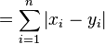
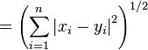
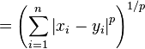
Examples of numeric distance functions
For any two n-dimensional numeric vectors (x₁, x₂, ...,x_{n}) and (y₁, y₂, ...,y_{n}), we can use the following distance functions:
The Manhattan distance is sometimes called taxicab distance because it is the distance a car would drive in a city laid out in square blocks, i.e., the car will drive along one dimension, then it will drive along the other dimension and so on.
1-norm distance | also called Manhattan distance
2-norm distance | also called Euclidean distance
p-norm distance
infinity norm distance

Slide 12
Example of symbolic distance functions
The Hamming distance between two strings of equal length is the number of positions at which the corresponding symbols are different. For example, the Hamming distance between “ABC” and “AAD” is 2 (the strings differ in two positions; and the Hamming distance between <red, blue, green> and <blue, blue, blue> is 2.
You can also use weighted Hamming distance in which different positions carry different weights. For example, if the first position is twice as important as the remaining positions, the distance between <bmw, 523> and <bmw,323> is 1 (the weight of the second position is 1, and the weight of the first position is 2), whereas the distance between <bmw,523> and <Volvo, s60> is 2+1 = 3.

Slide 13
Problems with distance measures: mixing numeric and categorical data
Mixing continuous and discrete attributes can be risky. Suppose our examples are described by three attributes: size, price, and season. Of these, the first two are continuous, and the last is categorical. Suppose that the data instance is x = (1, 100, summer) and y = (3, 150, winter). Suppose further that winter is modeled as 1 and summer is modeled as 0. A thoughtless application of the Euclidian distance, for example, can result in a situation where the difference between two prices (e.g., price1= 100 and price2 =150, which means that the difference between prices is 50) can totally dominate the difference between two seasons (which could not exceed 1). This observation is closely related to the problem of scaling, which we will discuss later.

Slide 14
Problems with distance measures: irrelevant attributes
Suppose we have two numeric attributes: body-temperature (the horizontal axis) and shoe-size (the vertical axis). The black dot stands for the object that the k-NN classifier is expected to label as healthy (pos) or sick (neg).
You can see that all positive examples find themselves in the shaded area delimited by two critical points along the “horizontal” attribute: temperatures exceeding the maximum indicate fever, and those below the minimum, hypothermia. As for the “vertical” attribute, we see that the positive and negative examples alike are distributed along the entire range, shoe-size being unable to contribute anything to a person’s health. The object we want to classify is in the highlighted region, and common sense requires that it should be labeled as positive—despite the fact that its nearest neighbor happens to be negative.

Slide 15
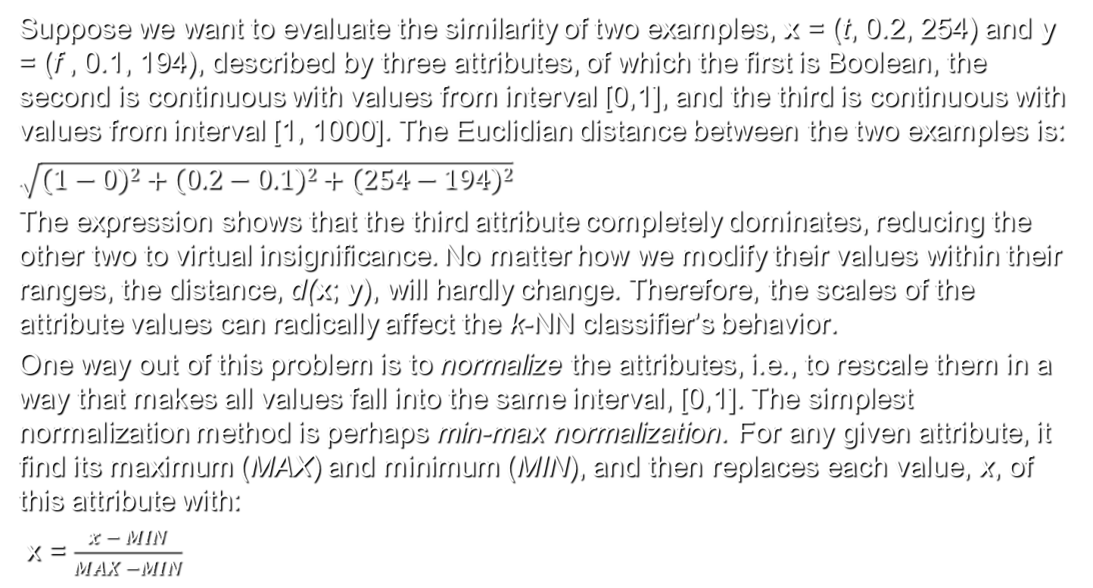
Problems with distance measures: scaling
Suppose we want to evaluate the similarity of two examples, x = (t, 0.2, 254) and y = (f , 0.1, 194), described by three attributes, of which the first is Boolean, the second is continuous with values from interval [0,1], and the third is continuous with values from interval [1, 1000]. The Euclidian distance between the two examples is:
$\sqrt{\left(1−0\right)2+\left(0.2−0.1\right)2+\left(254−194\right)2}$
The expression shows that the third attribute completely dominates, reducing the other two to virtual insignificance. No matter how we modify their values within their ranges, the distance, d(x; y), will hardly change. Therefore, the scales of the attribute values can radically affect the k-NN classifier’s behavior.
One way out of this problem is to normalize the attributes, i.e., to rescale them in a way that makes all values fall into the same interval, [0,1]. The simplest normalization method is perhaps min-max normalization. For any given attribute, it find its maximum (MAX) and minimum (MIN), and then replaces each value, x, of this attribute with:
x = $\frac{x − MIN}{MAX −MIN}$

Slide 16
Example: food classification (cont.)
Let’s go back to our example and label tomato. We need to measure the distance between tomato and the other food instances:
If we use 1-NN classification (i.e., k=1 and you are using the nearest neighbor), then the predicted food type for tomato is fruit because tomato’s nearest neighbor is orange (with distance 1.4) and the class of orange is fruit.
If we use 3-NN classification (i.e., k =3) with a simple majority vote among the nearest neighbors, then the predicted class for tomato is again fruit because the closest 3 neighbors are orange (class=fruit), grape (distance = 2.2, class = fruit), and nuts (distance = 3.6, class = proteins) and the majority class among the three neighbors is fruit.

Slide 17
Variance bias tradeoff
There are two sources of the classifier’s errors: variance and bias. Because different samples of training data can be used to create a classifier, the sample that is used as a training set to create a particular classifier almost never captures all aspects of the underlying classes. This is partly due to the way the training set has been created. In some applications, the training set has been created at random. In other cases, it consists of examples available at the given moment. In addition, the training set could have been created by an expert who is inevitably subjective. The problem is that different training sets will produce different classifiers that will differ in their predictions. This is what we mean by variance and by saying that variance in the training data is an important source of error.
A classifier is biased if the average predictions of different classifiers (based on different training sets) systematically miss the target. For example, an algorithm with high bias can miss important relations between features. Often, the bias stems from erroneous assumptions in the learning algorithm.

Slide 18
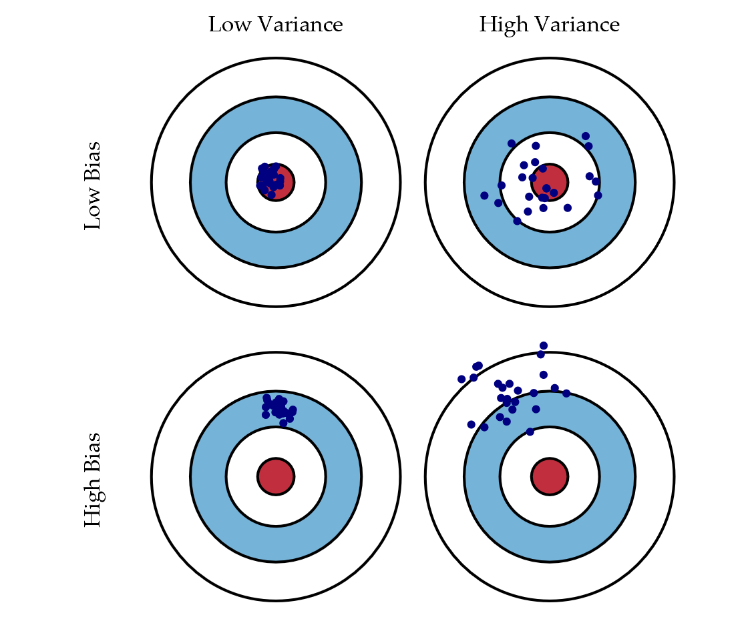
Variance bias tradeoff (cont.)

Slide 19
Variance bias tradeoff (cont.)
In the low-variance/low-bias case, the predictions on average are correct because they are centered around the target (by average we mean predictions produced from different training sets). The variance is also low because the predictions are centered closely around the target.
In the low-bias/high variance case, the predictions on average are correct (their mean is the target). However, there are scattered around the target.
In the high bias/low variance case, the predictions are centered around a single point, which differs from the target, hence the bias.
In the high bias/high variance case, the predictions systematically miss the target (i.e., they are centered around a different point) and they are scattered.

Slide 20
Overfitting vs underfiting
A learning algorithm might overfit data if is it is very accurate on training data but less accurate in predicting new data. In other words, overfittig produces a model that works too well on training data but fails to generalize to unseen data. Overfitting is often a result of complex learning models or of learning models that adjust to nosy or random irrelevant features of the training data. Overfitting can make the model sensitive to small fluctuations in the training set and, therefore, increase the variance error.
A learning algorithm is said to underfit training data if it is less accurate in fitting training data. For example, the algorithm might fail to capture important data regularities. Underfitting often leads to less variance (unresponsiveness to the training set) and higher bias. In the extreme case, a classifier might not fit any data at all and might output the same constant prediction for every new data instance. As a result, the classifier has zero variance and high bias.

Slide 21
Variance bias tradeoff (cont.)
The bias–variance tradeoff is a central problem in machine learning. In general, we want to create a model that performs very well on training data and generalizes well to unseen data. Unfortunately, it is typically impossible to reduce both errors. That is, reducing bias comes at the cost of increasing variance and vice versa.
Models that work very well on their training sets are at risk of overfitting noisy or unrepresentative training data and tend to have high variance. In contrast, algorithms that do not perform very well on their training sets don't tend to overfit, but may underfit their training data, thereby creating high bias.
In other words, one of the problems is to find the right balance between bias and variance.

Slide 22
How to choose k?
The value of k in the kNN algorithm can have a large effect on the behavior of the algorithm. When k=1, the resulting prediction surface is very wiggly. As a result, the method might not work well on predicting future data.

Slide 23
How to choose k? (cont.)
As k increases, the prediction surface becomes smoother until, in the limit of k=N, we end up with predicting the majority label of the whole data set.

Slide 24
kNN: Variance bias tradeoff
Wen k is large, the algorithm loses its precision and attention to detail because some important regularities can get neglected. In other words, large k tend to produce more bias and less variability. In the extreme case when k=N, the algorithm would always predict the majority class, regardless of the nearest neighbors. Although the variability is zero (the prediction is always the same), the result is biased: the algorithm prediction tends to differ from the correct one.
On the other hand, when k is small, the algorithm might overfit data, allowing unimportant features to influence the classification of examples. In other words, the algorithm tens to produce more variability and less bias.

Slide 25
Avoiding overfitting in kNN
A training set includes two types of data instances: instances that are relevant for the classification and irrelevant instances also called noise. The more noisy the training set is, the more difficult the prediction is because more noise must be ignored. The problem is how to find noisy instances. One heuristic often used is the following: remove a data instance if all its neighbors are of another class.
A learning algorithm that can reduce the chance of fitting noise is called robust.
Another technique used to adjust k in order to avoid overfitting is cross-validation. In general, in cross-validation, we use one sample to train a classifier and another sample to test its performance. Two commonly used cross-validation methods are 2-fold cross-validation and k-fold cross validation.
In 2-fold cross validation, the initial data set is randomly divided into two sets of equal size A and B. The classifier is then trained on A and tested on B, followed by training on B and testing on A.
In k-fold cross-validation, the initial data set is partitioned into k equally-sized subsets. Each subset is used as a test set for a classifier trained on the remaining k -1 subsets. The empirical accuracy is given by the average of the accuracies of these k classifiers.

Slide 26
Preparing data for use with k-NN
In order to use distance measures in k-NN features must be transformed to a standard range.
One method for rescaling features for k-NN is min-max normalization.
All normalized features fall in the range between 0 and 1, and each feature shows how far (from 0 percent to 100 percent) the original value fell along the range between the original minimum and maximum.
Another way to rescale features is by using z-score standardization:
The resulting value is the z-score, which tells how many standard deviations the feature falls above or below its mean value.

Slide 27
Preparing data for use with k-NN (cont.)
If the futures are nominal, they can be converted into numeric format using dummy coding, in which binary flags are used to indicate that a feature belongs to a specific category. For example, if the nominal variable gender has two levels, male and female, it can be coded with one binary flag, say male that indicates membership to the male class. That is male=1 if the data instance is male and male=0 if the data instance is not male (therefore it is female).
As another example, consider the case where temperature variable has three levels, hot, medium and cold. The variable can be coded with two binary flags. The first flag indicates if the data instance is hot and the second flag indicates if the data instance is medium. For instance, a data instance with hot temperature must be encoded as hot=1 and medium=0. A data instance with cold temperature must have hot=0 and medium=0.
Ordinal features could be coded with ordinal numbers. For example, if the levels of sweetness are coded on a scale from 1 to 10, one must ensure that the steps between different values represent equal intensity of sweetness, i.e., the difference between sweetness levels 7 and 6 is the same as the difference between sweetness levels 2 and 1.

Slide 28
Diagnosing breast cancer with k-NN: Collecting data
We will apply the k-NN algorithm to measurements of biopsied cells from women with abnormal breast masses in order to automatically detect cancer.
The textbook uses the Wisconsin Breast Cancer Diagnostic dataset from the UCI Machine Learning Repository at http://archive.ics.uci.edu/ml. The data includes the measurements from digitized images of fine-needle aspirate of breast mass.
You can download the data set from Blackboard. Save the file wisc_bc_data.csv in your working directory.
The breast cancer data includes 569 examples of cancer biopsies, each with 32 features. One feature is an identification number, another is the cancer diagnosis, and there are 30 numeric-valued laboratory measurements. The diagnosis is coded as "M" to indicate malignant or "B" to indicate benign.
The other 30 numeric measurements comprise the mean, standard error, and worst (that is, largest) value for 10 different characteristics of the digitized cell nuclei. These include: Radius, Texture, Perimeter, Area, Smoothness, Compactness, Concavity, Concave points, Symmetry, and Fractal dimension.

Slide 29
Diagnosing breast cancer with k-NN: exploring and preparing the data
First, we will import the data into the wbcd data frame:
> wbcd <- read.csv("wisc_bc_data.csv", stringsAsFactors = FALSE)
The str(wbcd) command gives us a brief look at the data:
> str(wbcd)
'data.frame': 569 obs. of 32 variables:
$ id : int 87139402 8910251 905520 868871 9012568 906539 925291 87880 862989 89827 ...
$ diagnosis : chr "B" "B" "B" "B" ...
$ radius_mean : num 12.3 10.6 11 11.3 15.2 ...
$ texture_mean : num 12.4 18.9 16.8 13.4 13.2 ...
$ perimeter_mean : num 78.8 69.3 70.9 73 97.7 ...
………………………………………………………
The first variable is the patient ID. Its numeric value is useless for the purposes of k-NN, i.e., we cannot use the patient ID as an attribute to the distance function. We will make a copy of the data frame which does not include the patient ID:
> wbcd <- wbcd[-1] # since the first column has a minus sign # it is excluded from the copy

Slide 30
Diagnosing breast cancer with k-NN: exploring and preparing the data (cont.)
The variable diagnosis indicates whether the patient has a benign or malignant mass. The next command labels the two levels of the diagnosis variable, “B” and “M”, as “Benign” and “Malignant”:
> wbcd$diagnosis<- factor(wbcd$diagnosis, levels = c("B", "M"),
labels = c("Benign", "Malignant"))
We can see how many records are benign and how many are malignant:
> table(wbcd$diagnosis)
Benign Malignant
357 212
The same result can be shown in terms of rounded proportions:
> round(prop.table(table(wbcd$diagnosis)) * 100, digits = 1)
Benign Malignant
62.7 37.3

Slide 31
Diagnosing breast cancer with k-NN: normalizing numeric data
The remaining 30 features are all numeric and each one consists of three different measurements (the mean, the standard error and the largest value) of ten characteristics. We need to determine if the numeric features are appropriate for distance measuring in k-NN and if they need to be rescaled. The str() function shows that many features are measured on different scales. For example, area_mean is measured in terms of hundreds, whereas smoothness_mean is less than 1. This observation is also confirmed by the summary() function:
> summary(wbcd[c("radius_mean", "area_mean", "smoothness_mean")])
radius_mean area_mean smoothness_mean
Min. : 6.981 Min. : 143.5 Min. :0.05263
1st Qu.:11.700 1st Qu.: 420.3 1st Qu.:0.08637
Median :13.370 Median : 551.1 Median :0.09587
Mean :14.127 Mean : 654.9 Mean :0.09636
3rd Qu.:15.780 3rd Qu.: 782.7 3rd Qu.:0.10530
Max. :28.110 Max. :2501.0 Max. :0.16340

Slide 32
Diagnosing breast cancer with k-NN: normalizing numeric data (cont.)
We will normalize features using min-max normalization. First, we define normalize() function, which takes a vector x of numeric values, and for each value in x, subtracts the minimum value in x and divides by the range of values in x.
> normalize <- function(x) {
return ((x - min(x)) / (max(x) - min(x)))
}
Instead of normalizing each of the 30 numeric variables one by one, we will use the lapply() function to do the normalization at once. The function lapply(x, fun) returns a list of the same length as x, each element of which is the result of applying fun to the corresponding element of x.
> wbcd_n <- as.data.frame(lapply(wbcd[2:31], normalize))
Here, we have applied the normalize function to each feature and have converted the list returned by lapply() to a data frame, using the as.data.frame() function. The result was stored in wbcd_n. We skipped the first column because it contains the labels.

Slide 33
Diagnosing breast cancer with k-NN: creating training and test datasets
The next step is to split the data set into two sets, a training set and a test set. The test set will be used as a validation set to evaluate the performance of the algorithm. We will use the first 469 records for the training dataset and the remaining 100 for the test set. We can assume that the records in the original data set have been ordered randomly, and our choice of consecutive records in the training and the test sets are not biased. In general, both the training and the test set must be selected randomly. If the training and the test set are not random, it might happen that we train the model on one type of data and test it on another type, leading to discrepancy in results. The following two commands store the training and the test set into variables wbcd_train and wbcd_test, respectively. > wbcd_train <- wbcd_n[1:469, ] # selects all columns of the # first 469 rows
> wbcd_test <- wbcd_n[470:569, ] #selects all columns of the # last 100 rows
Before we can run the k-NN algorithm we must store the labels, i.e., the values of the diagnosis variables for each patient record:
> wbcd_train_labels <- wbcd[1:469, 1] # selects the first # column from rows 1:468
> wbcd_test_labels <- wbcd[470:569, 1] #selects the first # column from rows 470:569

Slide 34
Diagnosing breast cancer with k-NN: running the algorithm
One implementation of kNN is the knn() function from the package class. The function uses the majority vote of the k nearest neighbors to decide the label of a new data instance, with ties broken at random. The package class usually comes preinstalled. Before we can run the knn() function, we need to load the package:
> library(class)
The general format of the knn() function is as follows:
knn(train, test, cl, k = 1, l = 0, prob = FALSE, use.all = TRUE)
Where
train – matrix/vector or data frame of training set cases.
test – matrix/vector or data frame of test set cases.
cl - factor of true classifications of training set
k – the number of neighbors considered.
The attributes l, prob and use.all are optional. l is the minimum vote for definite decision, in other words, less than k-l dissenting votes are allowed. If prob is true, the proportion of the votes for the winning class are returned as attribute prob. use.all controls handling of ties. If true, all distances equal to the k-th largest are included. Otherwise, a random selection of distances equal to the k-th is chosen.
The knn() function returns a factor of classifications of the test set.

Slide 35
Diagnosing breast cancer with k-NN: running the algorithm (cont.)
Usually, one runs the knn() function with the following typical attributes:
knn(train, test, cl, k )
We run the knn() function, storing the vector of classified labels into wbcd_test_pred:
> wbcd_test_pred <- knn(train = wbcd_train, test = wbcd_test,
cl = wbcd_train_labels, k = 21)
The wbcd_test_pred is the prediction vector that holds the predicted values. What remains to be done is to evaluate the algorithm performance by comparing the prediction vector wbcd_test_pred with the test vector wbcd_test. Since both vectors are nominal (with values of Benign or Malignant), we can create a crosstab of predicted and true labels using the CrossTable function from the gmodels package.
> library(gmodels) # loads the gmodels package
> CrossTable(x = wbcd_test_labels, y = wbcd_test_pred,
prop.chisq=FALSE)
The crosstab is shown on the next slide.

Slide 36
Diagnosing breast cancer with k-NN: evaluating model performance
Cell Contents
|-------------------------|
| N |
| N / Row Total |
| N / Col Total |
| N / Table Total |
|-------------------------|
Total Observations in Table: 100
| wbcd_test_pred
wbcd_test_labels | Benign | Malignant | Row Total |
-----------------|-----------|-----------|-----------|
Benign | 61 | 0 | 61 |
| 1.000 | 0.000 | 0.610 |
| 0.968 | 0.000 | |
| 0.610 | 0.000 | |
-----------------|-----------|-----------|-----------|
Malignant | 2 | 37 | 39 |
| 0.051 | 0.949 | 0.390 |
| 0.032 | 1.000 | |
| 0.020 | 0.370 | |
-----------------|-----------|-----------|-----------|
Column Total | 63 | 37 | 100 |
| 0.630 | 0.370 | |
-----------------|-----------|-----------|-----------|

Slide 37
Diagnosing breast cancer with k-NN: evaluating model performance (cont.)
We can see a mismatch of 2 on the intersection of malignant row and Benign column. In general, the following errors are possible:
- False positive – a benign record is classified as malignant
- False negative – a malignant record is classified as benign.
In this particular scenario, false negatives are more dangerous than false positives because ill people will not get diagnosed correctly on time, allowing the cancer cells to spread.
The algorithm made two false negative errors (the entry on the intersection of malignant row and benign column) and zero false positive errors (the entry on benign row and malignant column) . In general the error rate is 2%: 98% of the examples were correctly classified.

Slide 38
Diagnosing breast cancer with k-NN: improving model performance (cont.)
One way to improve the k-NN algorithm performance is by adjusting k. Unfortunately, in our case, trying different k values with the same training and validation sets does not have significant impact on the algorithm performance. The worst case is k=1. The following diagram shows the number of false positives and false negatives for different values of k.
k value False negatives False positives Error total
1 1 3 4
5 2 0 2
10 4 0 4
15 3 0 3
25 3 0 3
30 4 0 4
40 4 0 4
60 4 0 4

Slide 39
Diagnosing breast cancer with k-NN: evaluating model performance (cont.)
Another technique that can be used to improve model performance is z-score normalization. As we know, the z-score measures how far (in terms of standard deviations) is each value is from the mean. Using z-score instead of min-max normalization allows the outliers to be weighted more heavily in the distance calculation since most values are usually within ±3 standard deviations from the mean. There is a built-in scale() function, which rescales values using the z-score standardization. The function can be applied directly to a data frame and there is no need to use the lapply() function:
> wbcd_z <- as.data.frame(scale(wbcd[-1]))
We have excluded the diagnosis value (column 1) from normalization since it is nominal. The result of the normalization is stored into wbcd_z.
We use the same records as training and validation sets:
> wbcd_train <- wbcd_z[1:469, ] # training set is extracted
> wbcd_test <- wbcd_z[470:569, ] # validation set is # extracted
> wbcd_train_labels <- wbcd[1:469, 1] # training labels
> wbcd_test_labels <- wbcd[470:569, 1] # test labels
We get 5 false negatives and z-score normalization does not improve performance in this particular case.

Slide 40
Diagnosing breast cancer with k-NN: evaluating model performance (cont.)
> wbcd_test_pred <- knn(train = wbcd_train, test = wbcd_test,
cl = wbcd_train_labels, k = 21) # runs the k-NN algorithm
> CrossTable(x = wbcd_test_labels, y = wbcd_test_pred,
prop.chisq = FALSE) # builds a crosstab
| wbcd_test_pred
wbcd_test_labels | Benign | Malignant | Row Total |
-----------------|-----------|-----------|-----------|
Benign | 61 | 0 | 61 |
| 1.000 | 0.000 | 0.610 |
| 0.924 | 0.000 | |
| 0.610 | 0.000 | |
-----------------|-----------|-----------|-----------|
Malignant | 5 | 34 | 39 |
| 0.128 | 0.872 | 0.390 |
| 0.076 | 1.000 | |
| 0.050 | 0.340 | |
-----------------|-----------|-----------|-----------|
Column Total | 66 | 34 | 100 |
| 0.660 | 0.340 | |
-----------------|-----------|-----------|-----------|

Slide 41
Diagnosing breast cancer with k-NN: evaluating model performance (cont.)
After the z-score normalization, we can try running the knn function with different values of k:
k value False negatives False positives Error total
1 3 2 5
5 2 1 3
10 3 1 4
15 3 0 3
25 5 0 5
30 5 0 5
40 4 0 4
60 5 0 5
For this particular problem, z-score normalization did not produce an improvement.

Slide 42
Probabilistic Learning –
Classification Using
Naive Bayes

Slide 43
Bayesian classifiers
The statement in your textbook that weather forecasts use data from past events to predict the weather is not quite correct. Short-term weather forecasts do not extrapolate past weather histories, instead they use complex computer models that take several inputs, such as the current weather conditions, and produce a probabilistic forecast. The computer models use several ML techniques to improve their performance.
The earliest attempts to use Bayesian classifiers go back to well before World War II. Then, nobody used the term machine learning , but the goal was essentially the same: predict an example’s class based on the known attribute values. Here is the essence of Bayesian classifiers: using the Bayesian probabilistic theory, calculate for each class the probability of the given example belonging to it, and then choose the class with the highest value. In general, Bayesian classification follows three steps:
- For each class C_{i} compute the probability P(C_{i}) of its occurring (we have a finite set of classes, C₁, C₂, C₃ …). These are called prior probabilities and they do not depend on the data example.
- Compute the conditional probability of observing the data example for each given class, P(D | C_{i}). This is called likelihood, i.e., how likely is to observe the data example D for a given class C_{i}.
- Choose the class with the maximum P(D | C_{i}) * P(C_{i}) .

Slide 44
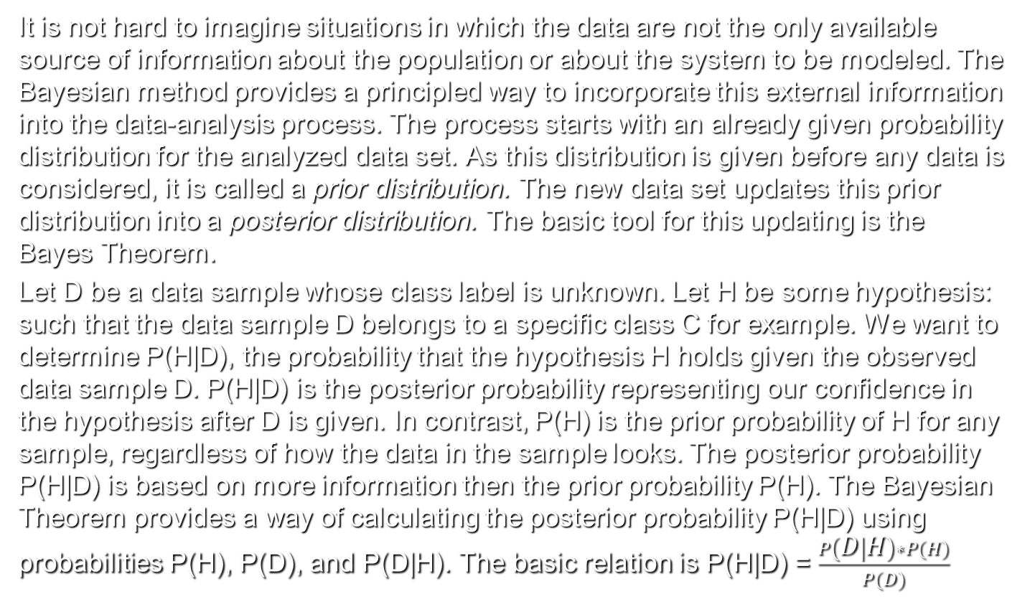
Bayesian classifiers (cont.)
It is not hard to imagine situations in which the data are not the only available source of information about the population or about the system to be modeled. The Bayesian method provides a principled way to incorporate this external information into the data-analysis process. The process starts with an already given probability distribution for the analyzed data set. As this distribution is given before any data is considered, it is called a prior distribution. The new data set updates this prior distribution into a posterior distribution. The basic tool for this updating is the Bayes Theorem.
Let D be a data sample whose class label is unknown. Let H be some hypothesis: such that the data sample D belongs to a specific class C for example. We want to determine P(H|D), the probability that the hypothesis H holds given the observed data sample D. P(H|D) is the posterior probability representing our confidence in the hypothesis after D is given. In contrast, P(H) is the prior probability of H for any sample, regardless of how the data in the sample looks. The posterior probability P(H|D) is based on more information then the prior probability P(H). The Bayesian Theorem provides a way of calculating the posterior probability P(H|D) using probabilities P(H), P(D), and P(D|H). The basic relation is P(H|D) = $\frac{P\left(D | H\right)∗P(H)}{P(D)}$

Slide 45
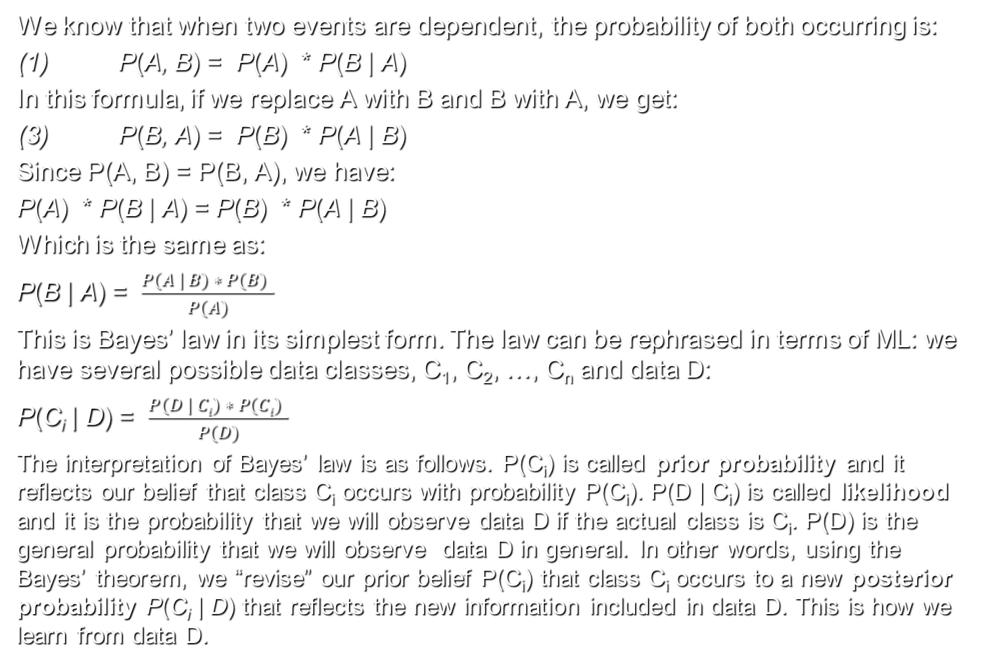
Bayes' theorem
We know that when two events are dependent, the probability of both occurring is:
(1) P(A, B) = P(A) * P(B | A)
In this formula, if we replace A with B and B with A, we get:
(3) P(B, A) = P(B) * P(A | B)
Since P(A, B) = P(B, A), we have:
P(A) * P(B | A) = P(B) * P(A | B)
Which is the same as:
P(B | A) = $\frac{P(A | B) ∗ P(B) }{P(A)}$
This is Bayes’ law in its simplest form. The law can be rephrased in terms of ML: we have several possible data classes, C₁, C₂, …, C_{n} and data D:
P(C_{i} | D) = $\frac{P(D | Ci) ∗ P(Ci) }{P(D)}$
The interpretation of Bayes’ law is as follows. P(C_{i}) is called prior probability and it reflects our belief that class C_{i} occurs with probability P(C_{i}). P(D | C_{i}) is called likelihood and it is the probability that we will observe data D if the actual class is C_{i}. P(D) is the general probability that we will observe data D in general. In other words, using the Bayes’ theorem, we “revise” our prior belief P(C_{i}) that class C_{i} occurs to a new posterior probability P(C_{i} | D) that reflects the new information included in data D. This is how we learn from data D.

Slide 46
Computing conditional probability with Bayes‘ theorem
As an example of how to use this rule, consider the following medical diagnosis problem. Suppose you are a woman in your 40s, and you decide to have a medical test for breast cancer called a mammogram. If the test is positive, what is the probability you have cancer? That obviously depends on how reliable the test is. Suppose you are told the test has a sensitivity of 80%, which means, if you have cancer, the test will be positive with probability 0.8. In other words:
P(pos | cancer) = 0.8 P(neg | cancer) = 1 – 0.8 = 0.2
Many people conclude they are 80% likely to have cancer. But this is false! It ignores the prior probability of having breast cancer, which fortunately is quite low:
P(cancer) = 0.004
Ignoring this prior is called the base rate fallacy. We also need to take into account the fact that the test may be a false positive or false alarm. Unfortunately, such false positives are quite likely (with current screening technology):
P(pos | ¬cancer) = 0.1
Therefore, P(neg | ¬cancer) = 1- 0.1 = 0.9

Slide 47
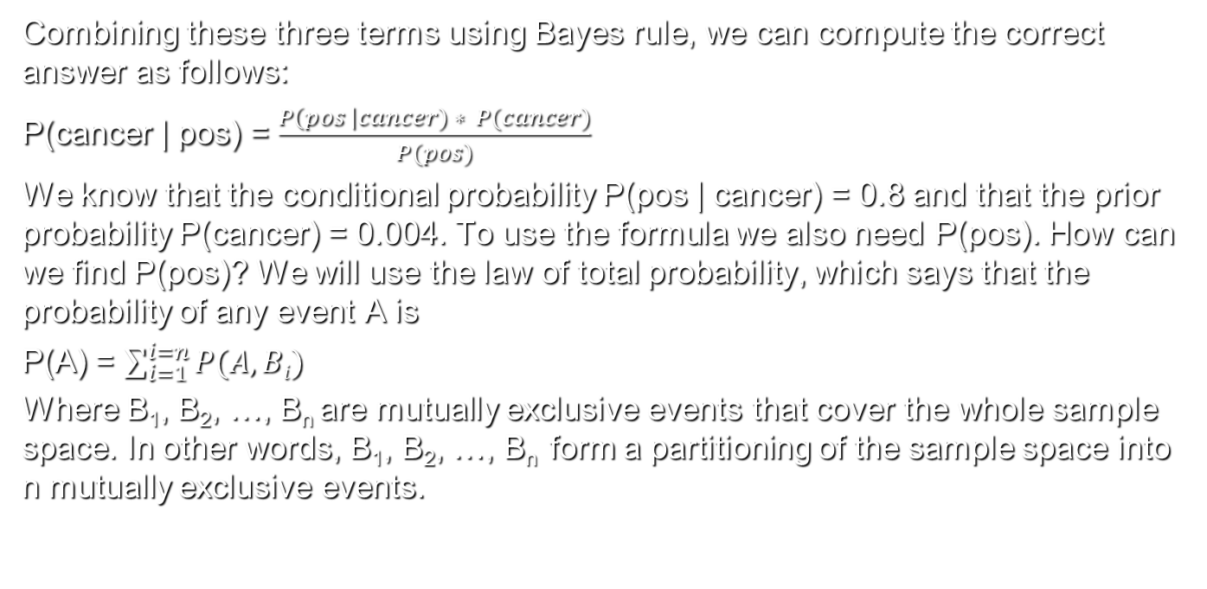
Computing conditional probability with Bayes‘ theorem (cont.)
Combining these three terms using Bayes rule, we can compute the correct answer as follows:
P(cancer | pos) = $\frac{P\left(pos \right|cancer) ∗ P(cancer)}{P(pos)}$
We know that the conditional probability P(pos | cancer) = 0.8 and that the prior probability P(cancer) = 0.004. To use the formula we also need P(pos). How can we find P(pos)? We will use the law of total probability, which says that the probability of any event A is
P(A) = $\sum_{i=1}^{i=n}{P(A, Bi)}$
Where B₁, B₂, …, B_{n} are mutually exclusive events that cover the whole sample space. In other words, B₁, B₂, …, B_{n} form a partitioning of the sample space into n mutually exclusive events.

Slide 48
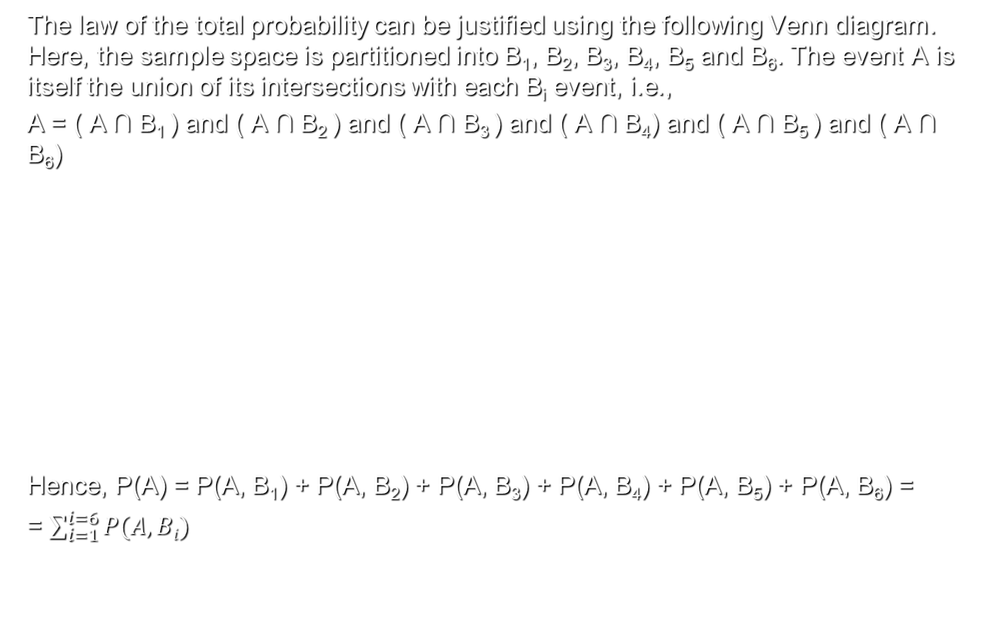
Computing conditional probability with Bayes‘ theorem (cont.)
The law of the total probability can be justified using the following Venn diagram. Here, the sample space is partitioned into B₁, B₂, B₃, B₄, B₅ and B₆. The event A is itself the union of its intersections with each B_{i} event, i.e.,
A = ( A ∩ B₁ ) and ( A ∩ B₂ ) and ( A ∩ B₃ ) and ( A ∩ B₄) and ( A ∩ B₅ ) and ( A ∩ B₆)
Hence, P(A) = P(A, B₁) + P(A, B₂) + P(A, B₃) + P(A, B₄) + P(A, B₅) + P(A, B₆) =
= $\sum_{i=1}^{i=6}{P(A, Bi)}$
B₁
B₂
B₆
A
A∩ B₁
A∩ B₂
A∩ B₆
A∩ B₃
B₃
A∩ B₅
A∩ B₄
B₅
B₄

Slide 49
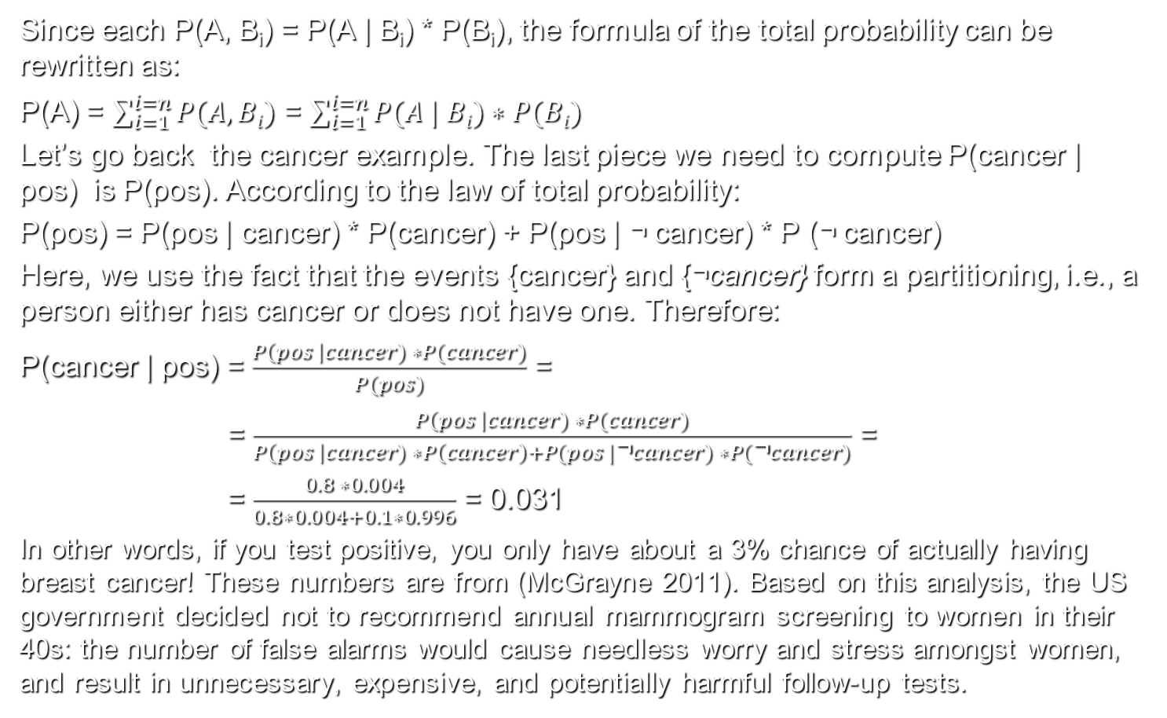
Computing conditional probability with Bayes‘ theorem (cont.)
Since each P(A, B_{i}) = P(A | B_{i}) * P(B_{i}), the formula of the total probability can be rewritten as:
P(A) = $\sum_{i=1}^{i=n}{P(A, Bi)}$ = $\sum_{i=1}^{i=n}{P(A | Bi)∗P(Bi)}$
Let’s go back the cancer example. The last piece we need to compute P(cancer | pos) is P(pos). According to the law of total probability:
P(pos) = P(pos | cancer) * P(cancer) + P(pos | ¬ cancer) * P (¬ cancer)
Here, we use the fact that the events {cancer} and {¬cancer} form a partitioning, i.e., a person either has cancer or does not have one. Therefore:
P(cancer | pos) = $\frac{P\left(pos \right|cancer) ∗P(cancer)}{P(pos)}$ =
= $\frac{P\left(pos \right|cancer) ∗P(cancer)}{P\left(pos \right|cancer) ∗P\left(cancer\right)+P(pos |\text{¬}cancer) ∗P(\text{¬}cancer)}$ =
= $\frac{0.8 ∗0.004}{0.8∗0.004+0.1∗0.996}$ = 0.031
In other words, if you test positive, you only have about a 3% chance of actually having breast cancer! These numbers are from (McGrayne 2011). Based on this analysis, the US government decided not to recommend annual mammogram screening to women in their 40s: the number of false alarms would cause needless worry and stress amongst women, and result in unnecessary, expensive, and potentially harmful follow-up tests.

Slide 50
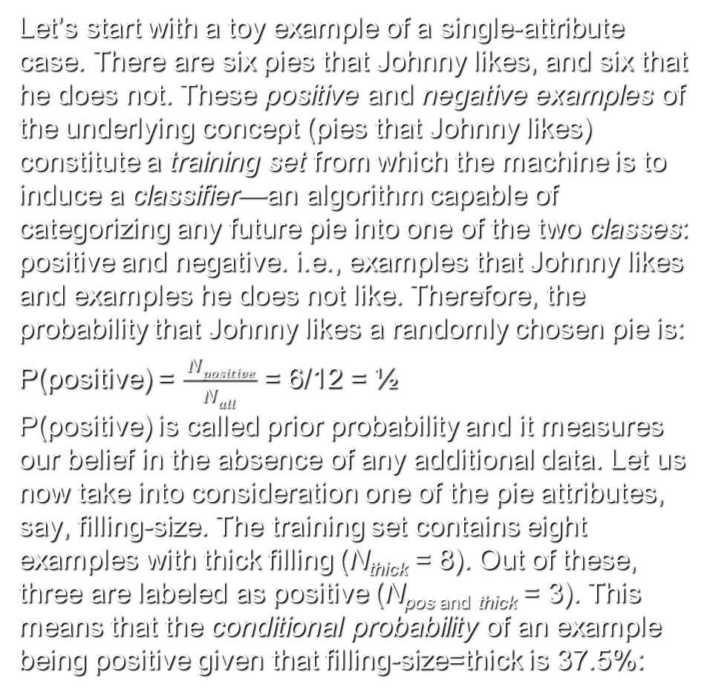
Toy example of Bayesian classifier: What Johnny likes
Let’s start with a toy example of a single-attribute case. There are six pies that Johnny likes, and six that he does not. These positive and negative examples of the underlying concept (pies that Johnny likes) constitute a training set from which the machine is to induce a classifier—an algorithm capable of categorizing any future pie into one of the two classes: positive and negative. i.e., examples that Johnny likes and examples he does not like. Therefore, the probability that Johnny likes a randomly chosen pie is:
P(positive) = $\frac{ Npositive}{Nall}$ = 6/12 = ½
P(positive) is called prior probability and it measures our belief in the absence of any additional data. Let us now take into consideration one of the pie attributes, say, filling-size. The training set contains eight examples with thick filling (N_{thick} = 8). Out of these, three are labeled as positive (N_{pos and} _{thick} = 3). This means that the conditional probability of an example being positive given that filling-size=thick is 37.5%:

Slide 51
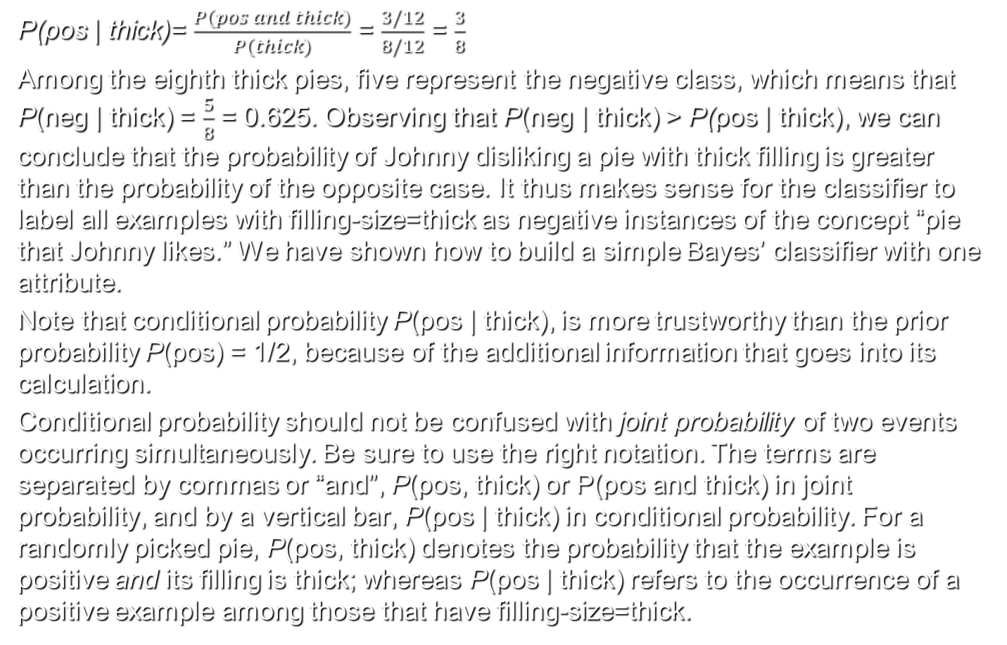
Toy example of Bayesian classifier: What Johnny likes (cont.)
P(pos | thick)= $\frac{P(pos and thick)}{P(thick)}$ = $\frac{3/12}{8/12}$ = $\frac{3}{8}$
Among the eighth thick pies, five represent the negative class, which means that P(neg | thick) = $\frac{5}{8}$ = 0.625. Observing that P(neg | thick) > P(pos | thick), we can conclude that the probability of Johnny disliking a pie with thick filling is greater than the probability of the opposite case. It thus makes sense for the classifier to label all examples with filling-size=thick as negative instances of the concept “pie that Johnny likes.” We have shown how to build a simple Bayes’ classifier with one attribute.
Note that conditional probability P(pos | thick), is more trustworthy than the prior probability P(pos) = 1/2, because of the additional information that goes into its calculation.
Conditional probability should not be confused with joint probability of two events occurring simultaneously. Be sure to use the right notation. The terms are separated by commas or “and”, P(pos, thick) or P(pos and thick) in joint probability, and by a vertical bar, P(pos | thick) in conditional probability. For a randomly picked pie, P(pos, thick) denotes the probability that the example is positive and its filling is thick; whereas P(pos | thick) refers to the occurrence of a positive example among those that have filling-size=thick.

Slide 52
Toy example of Bayesian classifier: What Johnny likes (cont.)
The figure on the right illustrates the terms. The rectangle represents all pies. The positive examples are contained in one circle and those with filling-size=thick in the other; the intersection contains three instances that satisfy both conditions; one pie satisfies neither, and is therefore left outside both circles. The conditional probability, P(pos | thick) = 3/8, is obtained by dividing the size of the intersection (three) by the size of the circle thick (eight). The joint probability, P(pos, thick) = 3/12, is obtained by dividing the size of the intersection (three) by the size of the entire training set (twelve). The prior probability of P(pos) = 6/12 is obtained by dividing the size of the circle pos (six) with that of the entire training set (twelve).

Slide 53
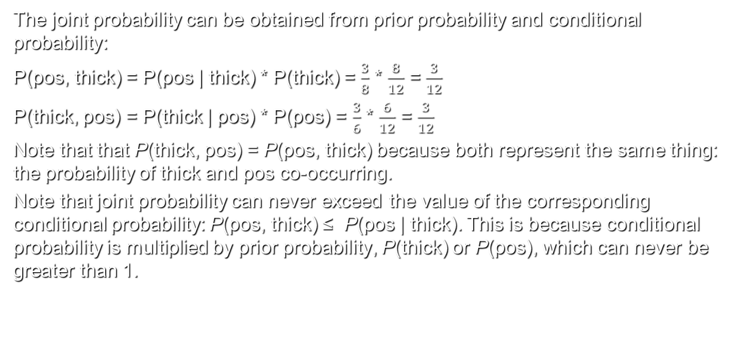
Toy example of Bayesian classifier: What Johnny likes (cont.)
The joint probability can be obtained from prior probability and conditional probability:
P(pos, thick) = P(pos | thick) * P(thick) = $\frac{3}{8}$ * $\frac{8}{12}$ = $\frac{3}{12}$
P(thick, pos) = P(thick | pos) * P(pos) = $\frac{3}{6}$ * $\frac{6}{12}$ = $\frac{3}{12}$
Note that that P(thick, pos) = P(pos, thick) because both represent the same thing: the probability of thick and pos co-occurring.
Note that joint probability can never exceed the value of the corresponding conditional probability: P(pos, thick) ≤ P(pos | thick). This is because conditional probability is multiplied by prior probability, P(thick) or P(pos), which can never be greater than 1.

Slide 54
Toy example Bayesian classifier: Spam filter
We want to build a Bayesian classifier with one attribute that filters spam email from non-spam (ham). Based on past experience, we know that spam massages occur with probability 0.2. The attribute we are going to use is the occurrence of the word “Viagra” in email. Obviously, the events {an email contains “Viagra”} and {an email is spam} are dependent. Since the word occurs in both spam and ham, we need to find the probability of the occurrence of “Viagra” in spam and the probability of its occurrence in ham. Suppose, that the probability of the occurrence of “Viagra” in spam is 4/20 and the probability of the occurrence of “Viagra” in ham is 1/80. Now, we are ready to apply the Bayes’ rule to find the posterior probability that a message is spam if it contains the word “Viagra”:

Slide 55
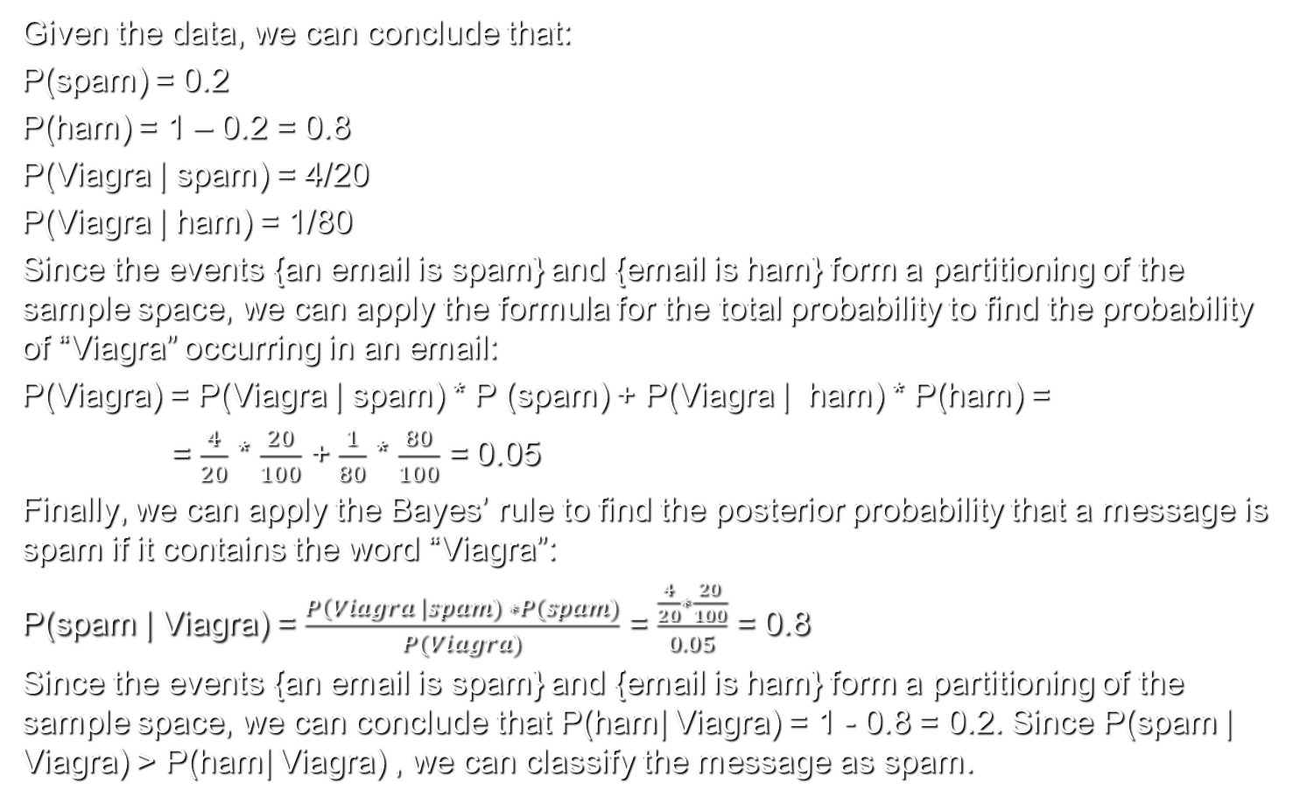
Toy example Bayesian classifier: Spam filter (cont.)
Given the data, we can conclude that:
P(spam) = 0.2
P(ham) = 1 – 0.2 = 0.8
P(Viagra | spam) = 4/20
P(Viagra | ham) = 1/80
Since the events {an email is spam} and {email is ham} form a partitioning of the sample space, we can apply the formula for the total probability to find the probability of “Viagra” occurring in an email:
P(Viagra) = P(Viagra | spam) * P (spam) + P(Viagra | ham) * P(ham) =
= $\frac{4}{20}$ * $\frac{20}{100}$ + $\frac{1}{80}$ * $\frac{80}{100}$ = 0.05
Finally, we can apply the Bayes’ rule to find the posterior probability that a message is spam if it contains the word “Viagra”:
P(spam | Viagra) = $\frac{P\left(Viagra \right|spam) ∗P(spam)}{P(Viagra)}$ = $\frac{\frac{4}{20}∗\frac{20}{100}}{0.05}$ = 0.8
Since the events {an email is spam} and {email is ham} form a partitioning of the sample space, we can conclude that P(ham| Viagra) = 1 - 0.8 = 0.2. Since P(spam | Viagra) > P(ham| Viagra) , we can classify the message as spam.

Slide 56
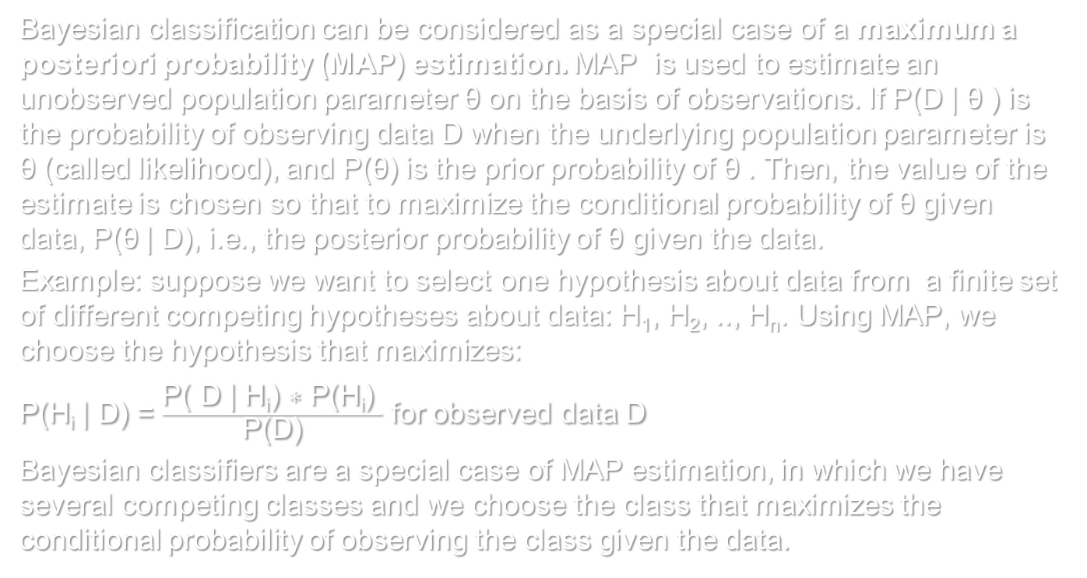
Maximum a posteriori probability (MAP) estimate
Bayesian classification can be considered as a special case of a maximum a posteriori probability (MAP) estimation. MAP is used to estimate an unobserved population parameter θ on the basis of observations. If P(D | θ ) is the probability of observing data D when the underlying population parameter is θ (called likelihood), and P(θ) is the prior probability of θ . Then, the value of the estimate is chosen so that to maximize the conditional probability of θ given data, P(θ | D), i.e., the posterior probability of θ given the data.
Example: suppose we want to select one hypothesis about data from a finite set of different competing hypotheses about data: H₁, H₂, .., H_{n}. Using MAP, we choose the hypothesis that maximizes:
P(H_{i} | D) = $\frac{\text{P}\text{( }\text{D}\text{ | }\text{Hi}\text{) ∗ }\text{P}\text{(}\text{Hi}\text{) }}{\text{P}\text{(}\text{D}\text{)}}$ for observed data D
Bayesian classifiers are a special case of MAP estimation, in which we have several competing classes and we choose the class that maximizes the conditional probability of observing the class given the data.

Slide 57
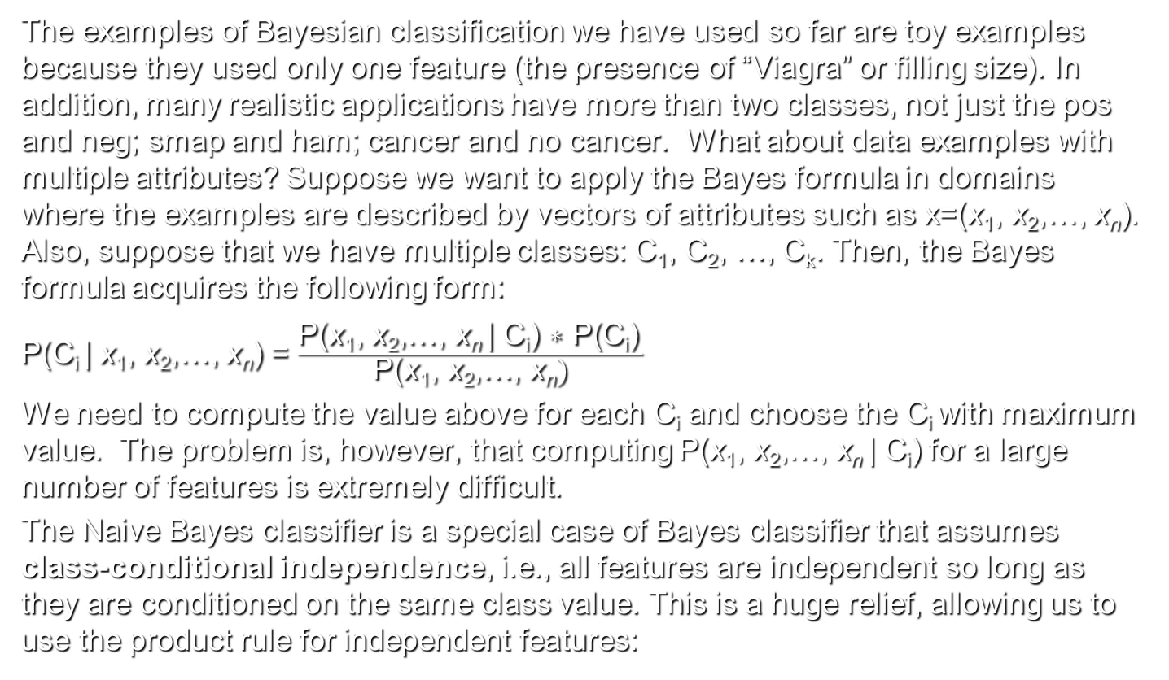
Naïve Bayes classifier
The examples of Bayesian classification we have used so far are toy examples because they used only one feature (the presence of “Viagra” or filling size). In addition, many realistic applications have more than two classes, not just the pos and neg; smap and ham; cancer and no cancer. What about data examples with multiple attributes? Suppose we want to apply the Bayes formula in domains where the examples are described by vectors of attributes such as x=(x₁, x₂,…, x_{n}). Also, suppose that we have multiple classes: C₁, C₂, …, C_{k}. Then, the Bayes formula acquires the following form:
P(C_{i} | x₁, x₂,…, x_{n}) = $\frac{\text{P}\text{(}\text{x}\text{1}\text{, }\text{x}\text{2}\text{,…, }\text{x}\text{n} \text{|} \text{C}\text{i}\text{)}\text{ ∗ }\text{P}\text{(}\text{Ci}\text{)} }{\text{P}\text{(}\text{x}\text{1}\text{, }\text{x}\text{2}\text{,…, }\text{x}\text{n})}$
We need to compute the value above for each C_{i} and choose the C_{i} with maximum value. The problem is, however, that computing $\text{P}\text{(}\text{x}\text{1}\text{, }\text{x}\text{2}\text{,…, }\text{x}\text{n} \text{| }\text{Ci}\text{) }$for a large number of features is extremely difficult.
The Naive Bayes classifier is a special case of Bayes classifier that assumes class-conditional independence, i.e., all features are independent so long as they are conditioned on the same class value. This is a huge relief, allowing us to use the product rule for independent features:

Slide 58
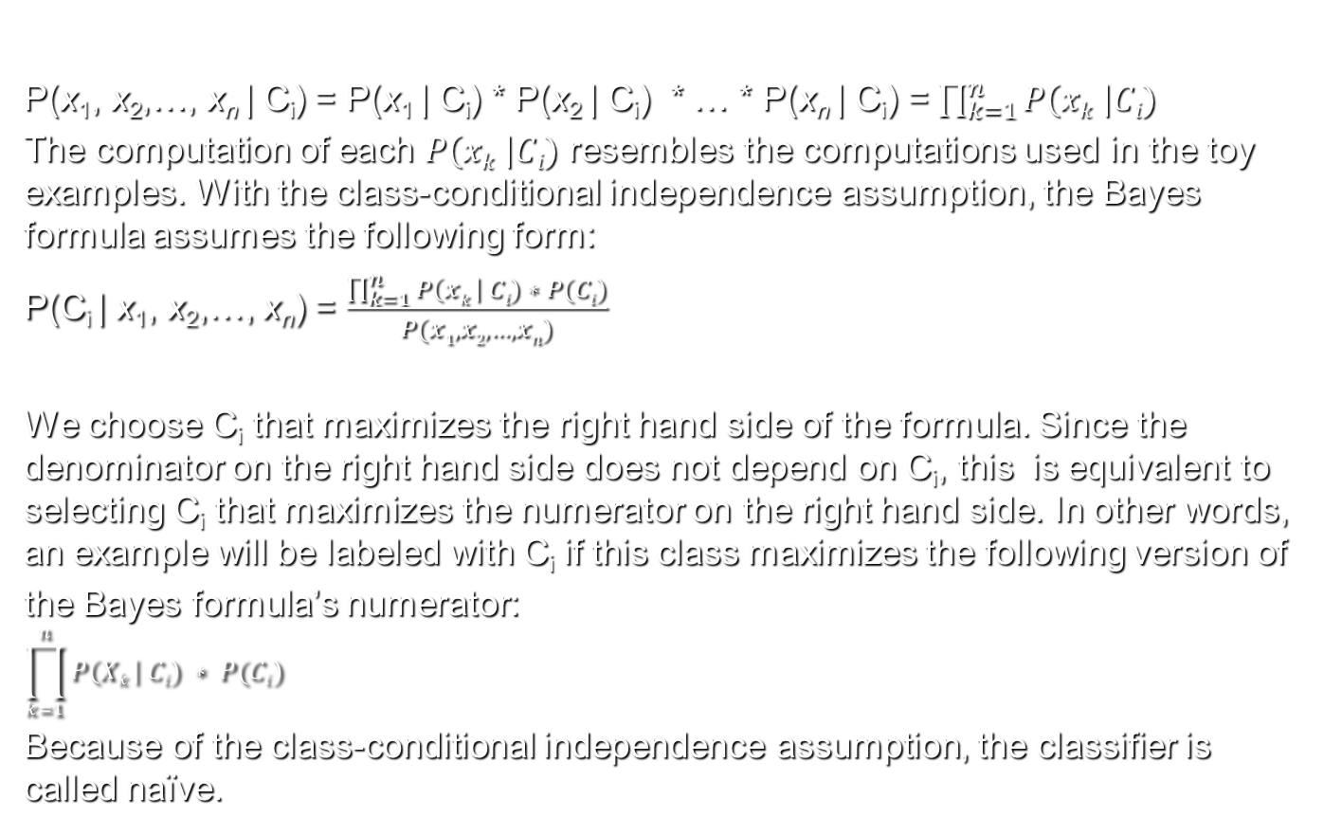
Naïve Bayes classifier (cont.)
$\text{P}\text{(}\text{x}\text{1}\text{, }\text{x}\text{2}\text{,…, }\text{x}\text{n} \text{| }\text{Ci}\text{)}$ = $\text{P}\text{(}\text{x}\text{1} \text{| }\text{Ci}\text{) }$* $\text{P}\text{(}\text{x}\text{2} \text{| }\text{Ci}\text{) }$ * … * $\text{P}\text{(}\text{x}\text{n} \text{| }\text{Ci}\text{) =}$ $\prod_{k=1}^{n}{P\left(xk \right|Ci)}$
The computation of each $P\left(xk \right|Ci)$ resembles the computations used in the toy examples. With the class-conditional independence assumption, the Bayes formula assumes the following form:
P(C_{i} | x₁, x₂,…, x_{n}) = $\frac{\prod_{k=1}^{n}{P\left(xk \right| Ci) ∗ P(Ci)}}{P(x1, x2, …, xn)}$
We choose C_{i} that maximizes the right hand side of the formula. Since the denominator on the right hand side does not depend on C_{i}, this is equivalent to selecting C_{i} that maximizes the numerator on the right hand side. In other words, an example will be labeled with C_{i} if this class maximizes the following version of
the Bayes formula’s numerator:
$$\prod_{k=1}^{n}{P\left(Xk \right| Ci) ∗ P(Ci)}$$
Because of the class-conditional independence assumption, the classifier is called naïve.

Slide 59
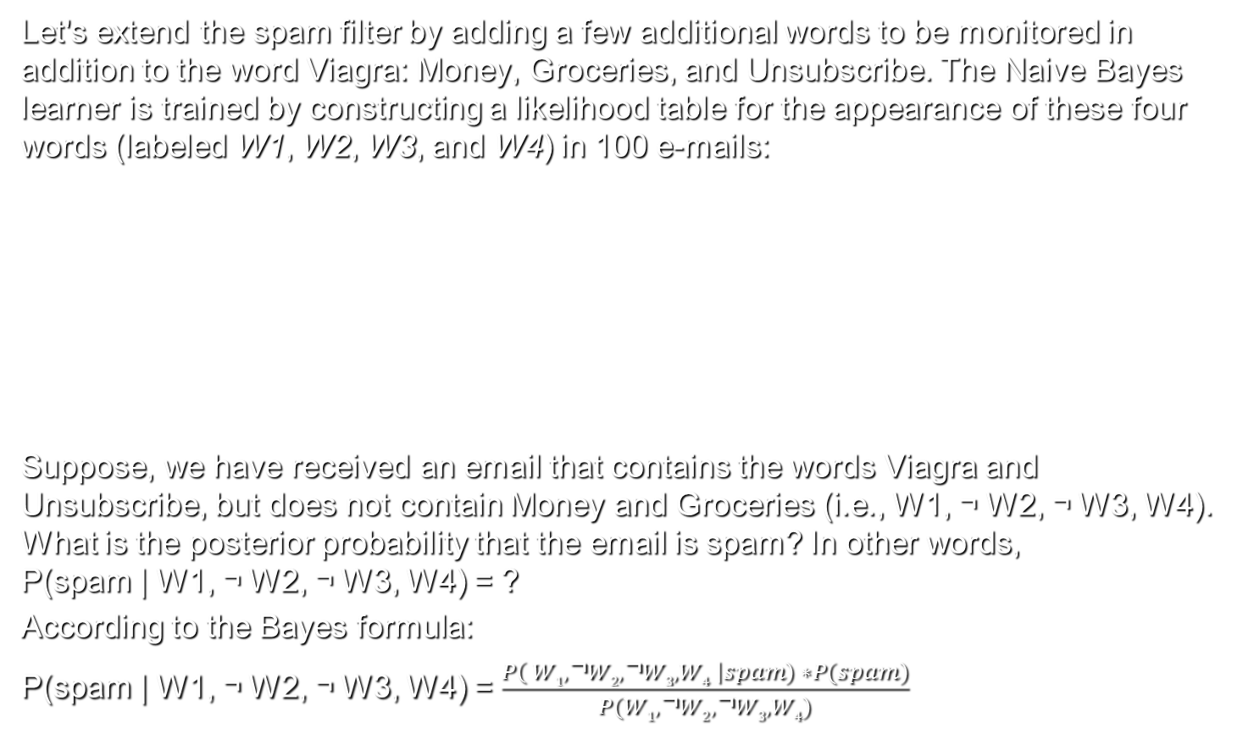
Spam filter with Naïve Bayes
Let's extend the spam filter by adding a few additional words to be monitored in addition to the word Viagra: Money, Groceries, and Unsubscribe. The Naive Bayes learner is trained by constructing a likelihood table for the appearance of these four words (labeled W1, W2, W3, and W4) in 100 e-mails:
Suppose, we have received an email that contains the words Viagra and Unsubscribe, but does not contain Money and Groceries (i.e., W1, ¬ W2, ¬ W3, W4). What is the posterior probability that the email is spam? In other words, P(spam | W1, ¬ W2, ¬ W3, W4) = ?
According to the Bayes formula:
P(spam | W1, ¬ W2, ¬ W3, W4) = $\frac{P\left( W1,\text{¬}W2,\text{¬}W3, W4 \right|spam) ∗P(spam)}{P(W1,\text{¬}W2,\text{¬}W3, W4)}$

Slide 60
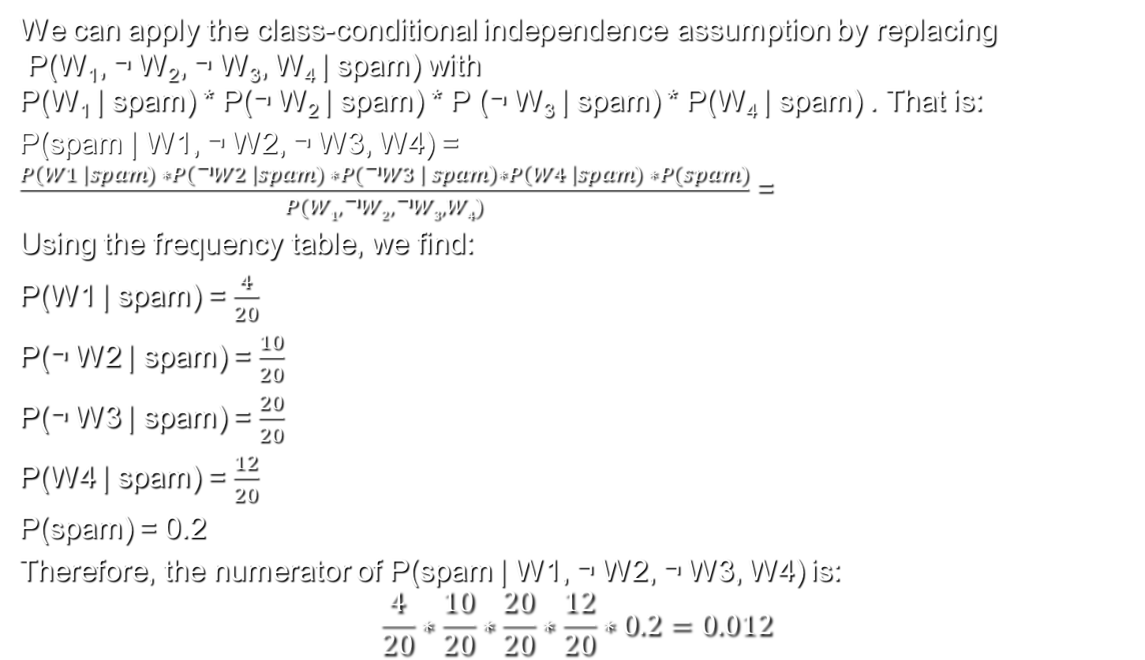
Spam filter with Naïve Bayes (cont.)
We can apply the class-conditional independence assumption by replacing P(W₁, ¬ W₂, ¬ W₃, W₄ | spam) with P(W₁ | spam) * P(¬ W₂ | spam) * P (¬ W₃ | spam) * P(W₄ | spam) . That is:
P(spam | W1, ¬ W2, ¬ W3, W4) = $\frac{P\left(W1 \right|spam) ∗P\left(\text{¬}W2 \right|spam) ∗P(\text{¬}W3 \left| spam\right)∗P\left(W4 \right|spam) ∗P(spam)}{P(W1,\text{¬}W2,\text{¬}W3, W4)}$ =
Using the frequency table, we find:
P(W1 | spam) = $\frac{4}{20}$
P(¬ W2 | spam) = $\frac{10}{20}$
P(¬ W3 | spam) = $\frac{20}{20}$
P(W4 | spam) = $\frac{12}{20}$
P(spam) = 0.2
Therefore, the numerator of P(spam | W1, ¬ W2, ¬ W3, W4) is:
$$\frac{4}{20}∗\frac{10}{20}∗\frac{20}{20}∗\frac{12}{20}∗0.2=0.012$$

Slide 61
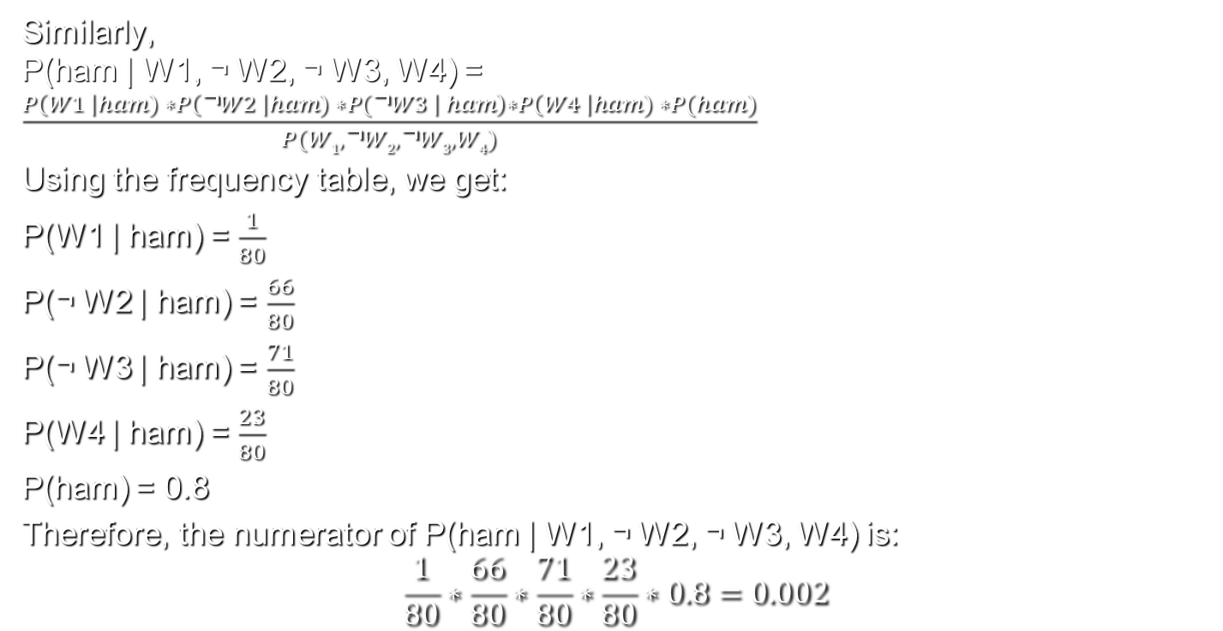
Spam filter with Naïve Bayes (cont.)
Similarly, P(ham | W1, ¬ W2, ¬ W3, W4) = $\frac{P\left(W1 \right|ham) ∗P\left(\text{¬}W2 \right|ham) ∗P(\text{¬}W3 \left| ham\right)∗P\left(W4 \right|ham) ∗P(ham)}{P(W1,\text{¬}W2,\text{¬}W3, W4)}$
Using the frequency table, we get:
P(W1 | ham) = $\frac{1}{80}$
P(¬ W2 | ham) = $\frac{66}{80}$
P(¬ W3 | ham) = $\frac{71}{80}$
P(W4 | ham) = $\frac{23}{80}$
P(ham) = 0.8
Therefore, the numerator of P(ham | W1, ¬ W2, ¬ W3, W4) is:
$$\frac{1}{80}∗\frac{66}{80}∗\frac{71}{80}∗\frac{23}{80}∗0.8=0.002$$

Slide 62
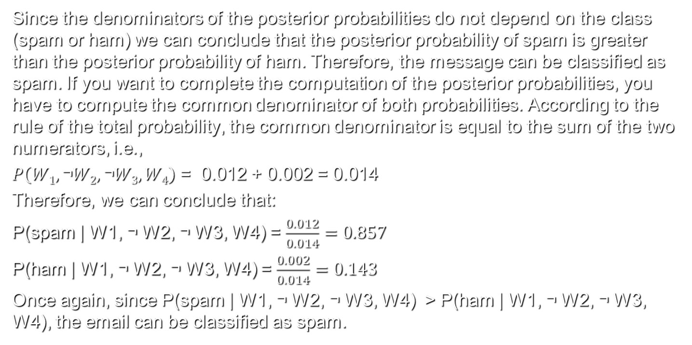
Spam filter with Naïve Bayes (cont.)
Since the denominators of the posterior probabilities do not depend on the class (spam or ham) we can conclude that the posterior probability of spam is greater than the posterior probability of ham. Therefore, the message can be classified as spam. If you want to complete the computation of the posterior probabilities, you have to compute the common denominator of both probabilities. According to the rule of the total probability, the common denominator is equal to the sum of the two numerators, i.e.,
$P\left(W1,\text{¬}W2,\text{¬}W3, W4\right)$ = 0.012 + 0.002 = 0.014
Therefore, we can conclude that:
P(spam | W1, ¬ W2, ¬ W3, W4) = $\frac{0.012}{0.014}=0.857$
P(ham | W1, ¬ W2, ¬ W3, W4) = $\frac{0.002}{0.014}=0.143$
Once again, since P(spam | W1, ¬ W2, ¬ W3, W4) > P(ham | W1, ¬ W2, ¬ W3, W4), the email can be classified as spam.

Slide 63
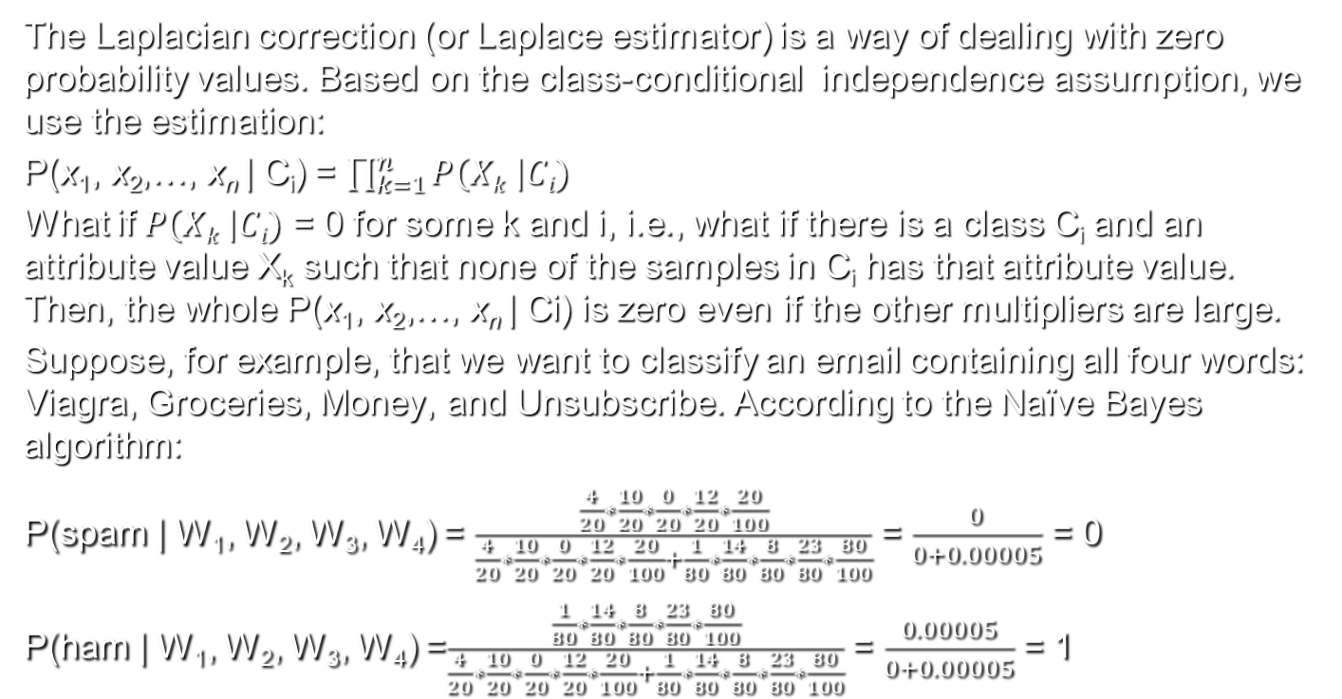
Laplacian correction
The Laplacian correction (or Laplace estimator) is a way of dealing with zero probability values. Based on the class-conditional independence assumption, we use the estimation:
$\text{P}\text{(}\text{x}\text{1}\text{, }\text{x}\text{2}\text{,…, }\text{x}\text{n} \text{| }\text{Ci}\text{)}$ $\text{=}$ $\prod_{k=1}^{n}{P\left(Xk \right|Ci)}$
What if $P\left(Xk \right|Ci)$ = 0 for some k and i, i.e., what if there is a class C_{i} and an attribute value X_{k} such that none of the samples in C_{i} has that attribute value. Then, the whole $\text{P}\text{(}\text{x}\text{1}\text{, }\text{x}\text{2}\text{,…, }\text{x}\text{n} \text{| }\text{Ci}\text{)}$ is zero even if the other multipliers are large.
Suppose, for example, that we want to classify an email containing all four words: Viagra, Groceries, Money, and Unsubscribe. According to the Naïve Bayes algorithm:
P(spam | W₁, W₂, W₃, W₄) = $\frac{\frac{4}{20}∗\frac{10}{20}∗\frac{0}{20}∗\frac{12}{20}∗\frac{20}{100}}{\frac{4}{20}∗\frac{10}{20}∗\frac{0}{20}∗\frac{12}{20}∗\frac{20}{100}+\frac{1}{80}∗\frac{14}{80}∗\frac{8}{80}∗\frac{23}{80}∗\frac{80}{100}}$ = $\frac{0}{0+0.00005}$ = 0
P(ham | W₁, W₂, W₃, W₄) =$\frac{\frac{1}{80}∗\frac{14}{80}∗\frac{8}{80}∗\frac{23}{80}∗\frac{80}{100}}{\frac{4}{20}∗\frac{10}{20}∗\frac{0}{20}∗\frac{12}{20}∗\frac{20}{100}+\frac{1}{80}∗\frac{14}{80}∗\frac{8}{80}∗\frac{23}{80}∗\frac{80}{100}}$ = $\frac{0.00005}{0+0.00005}$ = 1

Slide 64
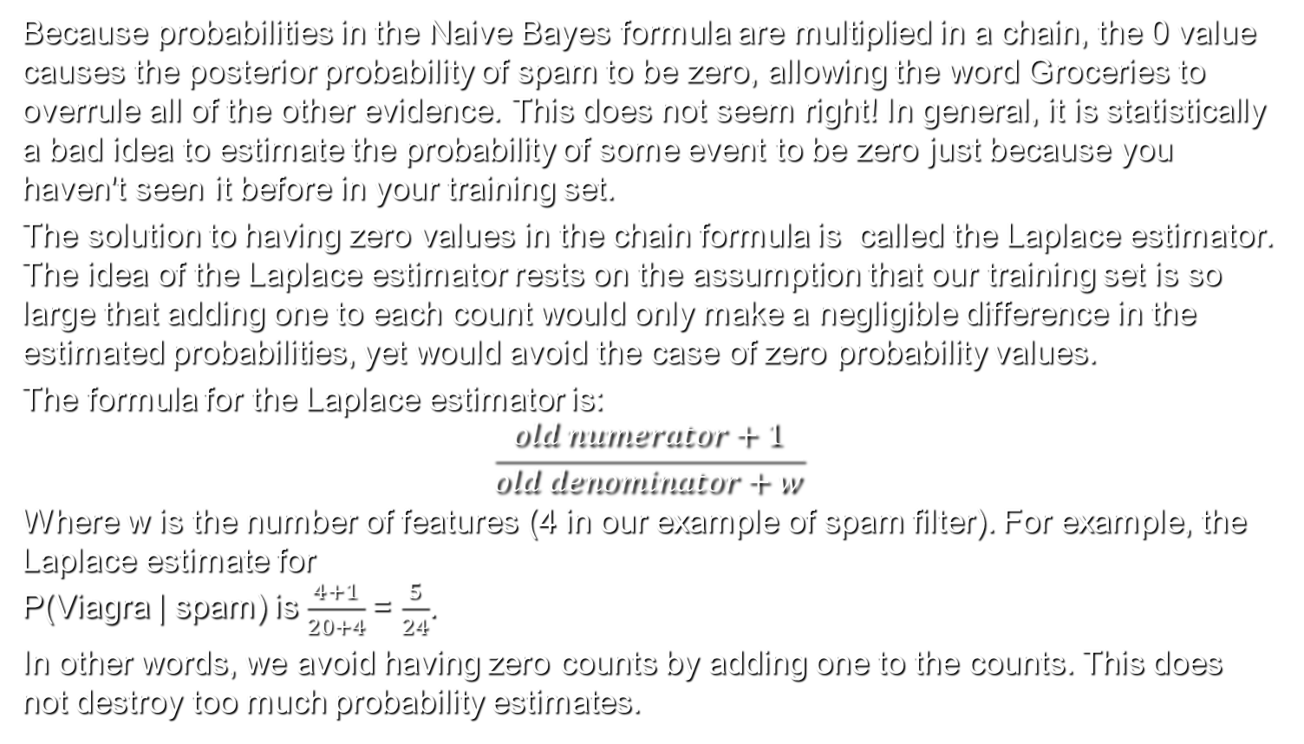
Laplacian correction (cont.)
Because probabilities in the Naive Bayes formula are multiplied in a chain, the 0 value causes the posterior probability of spam to be zero, allowing the word Groceries to overrule all of the other evidence. This does not seem right! In general, it is statistically a bad idea to estimate the probability of some event to be zero just because you haven't seen it before in your training set.
The solution to having zero values in the chain formula is called the Laplace estimator. The idea of the Laplace estimator rests on the assumption that our training set is so large that adding one to each count would only make a negligible difference in the estimated probabilities, yet would avoid the case of zero probability values.
The formula for the Laplace estimator is:
$$\frac{old numerator+1}{old denominator+w}$$
Where w is the number of features (4 in our example of spam filter). For example, the Laplace estimate for P(Viagra | spam) is $\frac{4+1}{20+4}$= $\frac{5}{24}$.
In other words, we avoid having zero counts by adding one to the counts. This does not destroy too much probability estimates.

Slide 65
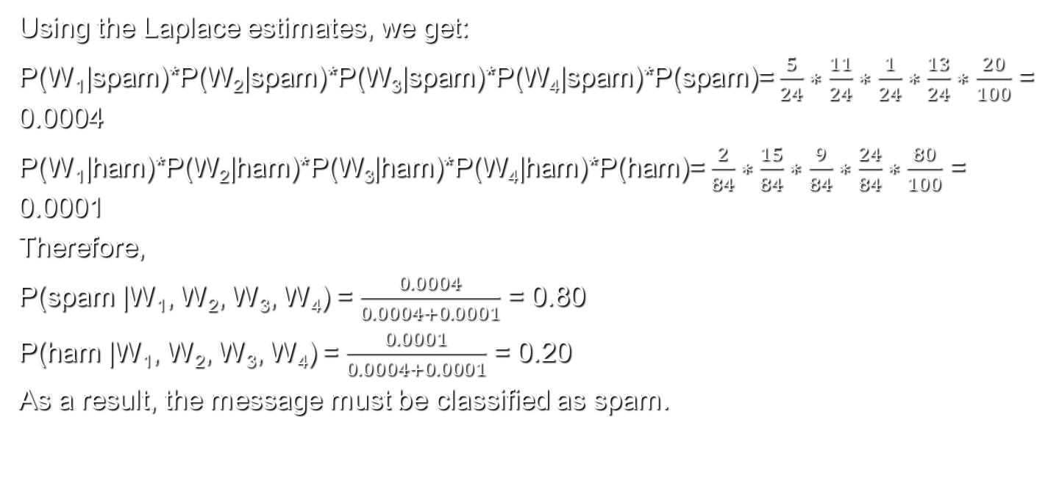
Laplacian correction (cont.)
Using the Laplace estimates, we get:
P(W₁|spam)*P(W₂|spam)*P(W₃|spam)*P(W₄|spam)*P(spam)= $\frac{5}{24}∗\frac{11}{24}∗\frac{1}{24}∗\frac{13}{24}∗\frac{20}{100}$ = 0.0004
P(W₁|ham)*P(W₂|ham)*P(W₃|ham)*P(W₄|ham)*P(ham)= $\frac{2}{84}∗\frac{15}{84}∗\frac{9}{84}∗\frac{24}{84}∗\frac{80}{100}$ = 0.0001
Therefore,
P(spam |W₁, W₂, W₃, W₄) = $\frac{0.0004}{0.0004+0.0001}$ = 0.80
P(ham |W₁, W₂, W₃, W₄) = $\frac{0.0001}{0.0004+0.0001}$ = 0.20
As a result, the message must be classified as spam.

Slide 66
Using numeric features with Naive Bayes
Because Naive Bayes uses frequency tables to learn the data, each feature must be categorical in order to create the combinations of class and feature values comprising of the matrix. Since numeric features do not have categories of values, Naive Bayes does not work directly with numeric data.
One possibility is to discretize, i.e., divide the range of all numeric values onto multiple intervals. Suppose we get ourselves a separate bin for each of these intervals, and place a little black ball into the i-th bin for each training example whose value falls into the i-th interval. Then, we will reach the following situation:

Slide 67
Using numeric features with Naive Bayes (cont.)
The upper part shows the bins, side by side and the bottom chart plots the histogram over the individual subintervals.
If the training set is infinitely large, we can, theoretically speaking, keep reducing the lengths of the intervals until they become infinitesimally small. The result of the bin-filling exercise will then no longer be a step-function, but rather a continuous function, such as the one shown below, which could be used as an estimate of the probability density function of the training set data.

Slide 68
Mobile phone spam filter
In the rest of this lecture, we will show how to use Naïve Bayes and R to train and test a mobile phone spam filter. Download the dataset from Blackboard and store it into your working directory. Then, read the data and store it into sms_raw variable as a data frame:
> sms_raw <- read.csv("sms_spam.csv", stringsAsFactors = FALSE)
We can get a brief look at the dataset using the str() function:
> str(sms_raw)
'data.frame': 5559 obs. of 2 variables:
$ type: chr "ham" "ham" "ham" "spam" ...
$ text: chr "Hope you are having a good week. Just checking in" "K..give back my thanks." "Am also doing in cbe only. But have to pay." "complimentary 4 STAR Ibiza Holiday or £10,000 cash needs your URGENT collection. 09066364349 NOW from Landline not to lose out"| truncated ...
The dataset contains 5559 messages labeled “ham” or “spam”. The text element stores the raw messages. Since the labels are character strings, it is good to convert them into factors:
> sms_raw$type <- factor(sms_raw$type)
Using the table() function we can see that 747 of SMS messages in our data were labeled as spam:
> table(sms_raw$type)
ham spam
4812 747

Slide 69
Mobile phone spam filter
Before we can create and run Bayes classifier, we need to preprocess text messages. For example, we need to delete punctuation and irrelevant words, such as “and”, “or”, “the”, etc. We also need to divide messages into words, extract words and build frequency tables. Most of the text processing functionality is provided in the package “tm” created by Ingo Feinerer. In order to use the package we must install and load it:
> install.packages("tm")
> library(tm)
A short manual of how to use the package written by Ingo Feinerer can be obtained by running:
> vignette("tm")
NLP stands for Natural Language Processing and the tm package supports many NLP functions. In general, NLP is done on big text collections called corpora. You can create a corpus in tm using the VCorpus() function, which creates “a volatile corpus”, i.e., a corpus which resides in working memory. The lifetime of a volatile corpus is the lifetime of the R variable that refers to the corpus. In contrast, the PCorups() function creates “ a permanent corpus”, which is stored in permanent memory.

Slide 70
Mobile phone spam filter (cont.)
The following function creates a corpus called sms_corpus:
> sms_corpus <- VCorpus(VectorSource(sms_raw$text))
The function VectorSource() creates a source object from the sms_raw$text vector and passes the source object to the VCorpus() function. Other possible sources are DataframeSource, DirSource, URISource, "XMLSource" , and ZipSource.
The print() function provides a brief summary of the corpus a whole:
> print(sms_corpus)
<<VCorpus>>
Metadata: corpus specific: 0, document level (indexed): 0
Content: documents: 5559
The inspect(sms_corpus) function provides a brief summary of each element of the corpus. Because every corpus is a list, you can apply the inspect() function to specific elements:
> inspect(sms_corpus[5])
<<VCorpus>>
Metadata: corpus specific: 0, document level (indexed): 0
Content: documents: 1
[[1]]
<<PlainTextDocument>>
Metadata: 7
Content: chars: 161

Slide 71
Mobile phone spam filter (cont.)
To view the content of the 5th message you can run the following function:
> as.character(sms_corpus[[5]])
The following call (without the double brackets) yields:
> as.character(sms_corpus[5])
[1] "list(list(content = \"okmail: Dear Dave this is your final notice to collect your 4* Tenerife Holiday or #5000 CASH award! Call 09061743806 from landline. TCs SAE Box326 CW25WX 150ppm\", meta = list(author = character(0), datetimestamp = list(sec = 4.5269570350647, min = 4, hour = 11, mday = 2, mon = 11, year = 115, wday = 3, yday = 335, isdst = 0), description = character(0), heading = character(0), id = \"5\", language = \"en\", origin = character(0))))“
[2] "list()"
[3] "list()"
This shows that every component of the list is a list. Hence, the double brackets are needed.
To view several messages, we will apply lapply() function, which takes two arguments, a list and a function, and applies the function on each component of the list.

Slide 72
Mobile phone spam filter: text cleaning and standardization
> lapply(sms_corpus[5:6], as.character)
$`5`
[1] "okmail: Dear Dave this is your final notice to collect your 4* Tenerife Holiday or #5000 CASH award! Call 09061743806 from landline. TCs SAE Box326 CW25WX 150ppm"
$`6`
[1] "Aiya we discuss later lar... Pick u up at 4 is it?“
Before we can extract words from the corpus, you must standardize it. For example, we must convert all uppercase characters to lowercase characters. We will use the function tm_map() which takes a corpus and a transformation function as attributes and applies the transformation function to each document in the corpus.
> sms_corpus_clean <- tm_map(sms_corpus,
content_transformer(tolower))
Here, we have applied tolower() function to each document in sms_corpus. The function content_transformer() is used as a wrapper function to get and set the content of each document. The result is stored in a new corpus called sms_corpus_clean.

Slide 73
Mobile phone spam filter: text cleaning and standardization
Text standardization also includes removing all numbers because they do not count as separate words:
> sms_corpus_clean <- tm_map(sms_corpus_clean, removeNumbers)
Here, the removeNumbers() function does not use a wrapper function to get and set documents because removeNumbers() belongs to the tm package.
The next task is to remove the stop words, i.e., words such as “and”, “or”, “to”, “a”, “the”, which are often irrelevant to text mining. Instead of creating a list of stop words, we will use the built-in function stopwords(), which returns a list of 174 stop words in English.
The list of stop words will be used as an argument of the built-in function removeWords():
> sms_corpus_clean <- tm_map(sms_corpus_clean,
removeWords, stopwords())
The format of the tm_map function is a bit unusual: all arguments to the transformation (or mapping) function are listed after the transformation function. Here stopwords() is an argument of removeWords() and is listed right after removeWords().

Slide 74
Mobile phone spam filter: text cleaning and standardization
The next function call removes all punctuation symbols from the corpus:
> sms_corpus_clean <- tm_map(sms_corpus_clean, removePunctuation)
There is a caveat. After removing punctuation symbols, some words, which were previously separated by punctuation symbols can get concatenated in a single word:
> removePunctuation("Hey!John")
[1] "HeyJohn“
Instead of using removePunctuation(), one can use the following function, which replaces punctuation symbols with blank spaces:
> replacePunctuation <- function(x) {
gsub("[[:punct:]]+", " ", x)
}
Another important step in the standardization process is converting all inflected or derived words to their stems. This is called stemming. For example, the words "stemmer", "stemming", "stemmed" will all be reduced to "stem". Stemming allows different modifications of the same word to be counted as appearances of the same word. For example, "stemmer", "stemming", "stemmed" will all be counted as “stem”.

Slide 75
Mobile phone spam filter: text cleaning and standardization
We will use the stemDocument() function from SnowballC package to perform stemming:
> install.packages("SnowballC")
> library(SnowballC)
> sms_corpus_clean <- tm_map(sms_corpus_clean, stemDocument)
The last step in the cleaning and standardization process is removing additional white space using the stripWhitespace() function. The function removes only the additional white space, not the white space at all:
> stripWhitespace("Hello World! ")
[1] "Hello World! “
We will use once again tm_map to apply stripWhitespace to each document in the corpus:
> sms_corpus_clean <- tm_map(sms_corpus_clean, stripWhitespace)
This completes the cleaning and the standardization phase.

Slide 76
Mobile phone spam filter: splitting documents into words
The next phase is to split each document into words, a process called tokenization. The result is usually stored as a document-term matrix or term-document matrix. These are matrices that describe the frequency of terms that occur in a collection of documents. Suppose, for example, that we have the following two documents: D1 = “ML is hard” D2 = “ML is easy”
In the document-term matrix (DTM), rows represent documents and columns represent words (a.k.a terms):
The term-document matrix (TDM) is the inverse of the document-term matrix, i.e., rows represent words and columns represent documents.
 | ML | is | hard | easy
D1 | 1 | 1 | 1 | 0
D2 | 1 | 1 | 0 | 1

Slide 77
Mobile phone spam filter: splitting documents into words
A DTM can be created using the DocumentTermMatrix() function:
> sms_dtm <- DocumentTermMatrix(sms_corpus_clean)
The DocumentTermMatrix() function provides optional arguments that allow data cleaning, standardization, and tokenization to be done in a single function call:
> sms_dtm2 <- DocumentTermMatrix(sms_corpus, control = list(
tolower = TRUE,
removeNumbers = TRUE,
stopwords = TRUE,
removePunctuation = TRUE,
stemming = TRUE
))
There is a slight difference between sms_stm2 and sms_dtm due to the fact that the default options of the DocumentTermMatrix() function (especially the removal of stop words) slightly differ from the way we have done it in sms_dtm.

Slide 78
Mobile phone spam filter: creating training and test datasets
The next phase is to create the training and test datasets. We'll divide the data into two portions: 75 percent for training and 25 percent for testing. This corresponds to 4,169 documents for training and 1,390 documents for testing. Assuming that the documents are stored randomly, we can take the first 4,160 documents for the training set and the remaining documents for the test set. Text corpora are very much like data frames, allowing row and column selection:
> sms_dtm_train <- sms_dtm[1:4169, ]
> sms_dtm_test <- sms_dtm[4170:5559, ]
The next two commands extract the labels from the raw data:
> sms_train_labels <- sms_raw[1:4169, ]$type
> sms_test_labels <- sms_raw[4170:5559, ]$type

Slide 79

Visualizing text data: word clouds
A word or tag cloud is a visual representation of text data, in which words are scattered around with more important words (more frequent, for example) shown with bigger font size and different color.
Source: peekaboo-vision.blogspot.com

Slide 80
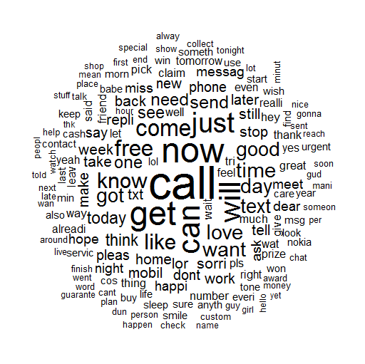
Visualizing text data: word clouds
We will use the wordcloud package:
> install.packages("wordcloud")
> library(wordcloud)
A wordcloud can be created with a single function call:
> wordcloud(sms_corpus_clean,
min.freq = 50, random.order =
FALSE)
Because the minimum frequency is 50, words with frequency below 50 are not plotted. A random.order = FALSE indicates that the words are plotted in order of decreasing frequency.

Slide 81
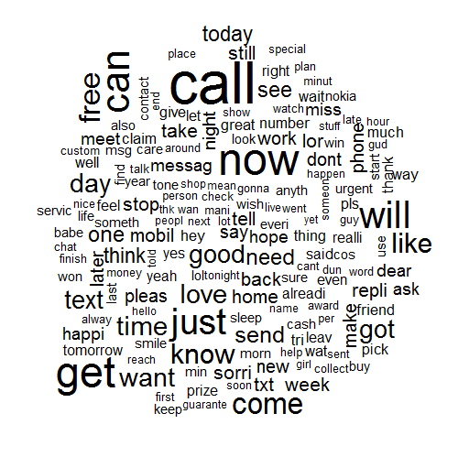
Visualizing text data: word clouds (cont.)
If you set default random.order=TRUE:
> wordcloud(sms_corpus_clean, min.freq = 50)

Slide 82
Visualizing text data: word clouds (cont.)
Let’s create word clouds for spam and ham and compare them. The subset() function extracts all records from a data frame (or a vector or matrix) that meet certain condition:
> spam <- subset(sms_raw, type == "spam")
> ham <- subset(sms_raw, type == "ham")
We have split the original data frame into two data frames, one that contains only spam messages and another that contains only ham messages.
> wordcloud(spam$text, max.words = 40, scale = c(3, 0.5))
> wordcloud(ham$text, max.words = 40, scale = c(3, 0.5))
The argument max.words limits the number of plotted words to 40, i.e., only the top 40 most frequent words are plotted. The argument scale defines the range of the font size to be used.
One can see that the most frequent words for spam are “call”, “mobile”, “txt”, “free”, etc., whereas the most frequent words for ham are “can”, “get”, “will”, “just”, etc.

Slide 83
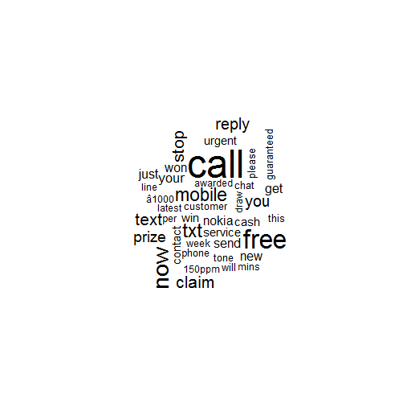
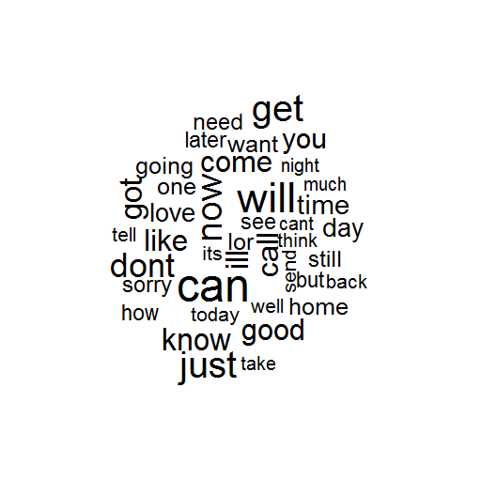
Visualizing text data: word clouds (cont.)
spam
ham

Slide 84
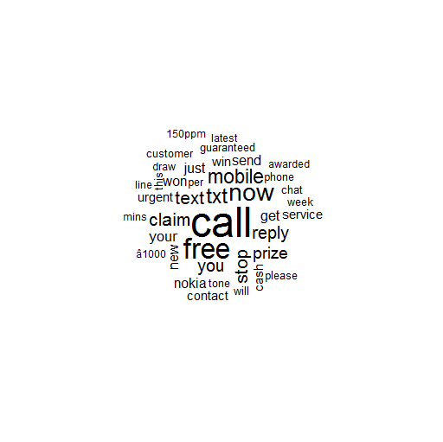
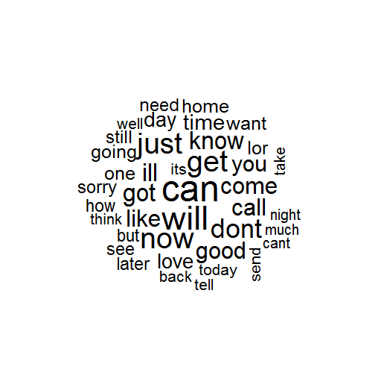
Visualizing text data: word clouds (cont.)
The word clouds for spam and ham without randomization:
spam
ham

Slide 85
Mobile phone spam filter: finding frequent words
The DTM we have created is sparse, i.e., most of its cells are zeroes. We will remove the words that appear no more than 5 times. First, we find the words that appear 5 time or more:
> sms_freq_words <- findFreqTerms(sms_dtm_train, 5)
The sms_freq_words vector includes all words that appear at least 5 times. Then, we apply column selection using the vector sms_freq_words as column index to select only the columns with the most frequent words from the training and the test datasets:
> sms_dtm_freq_train<- sms_dtm_train[ , sms_freq_words]
> sms_dtm_freq_test <- sms_dtm_test[ , sms_freq_words]
By doing this we have reduced the number of features (words) from about 7500 to 1180.
Since the Naive Bayes classifier is typically trained on data with categorical features (a feature is present or not), we will convert the numerical counts (of the appearances of a word in a document) in the DTM to categorical “Yes” or “No”. First, we define a function called convert_counts() which converts a numerical count to “Yes” if the count is greater than zero. Otherwise, the count is converted to “No”:

Slide 86
Mobile phone spam filter: finding frequent words
> convert_counts <- function(x) {
x <- ifelse(x > 0, "Yes", "No")
}
Then, we will apply the function convert_counts() to each column on the DTM. This will be done with the apply() function, which takes an array or matrix and a function as attributes and applies the function to each row or column:
> sms_train <- apply(sms_dtm_freq_train, MARGIN = 2,
convert_counts)
> sms_test <- apply(sms_dtm_freq_test, MARGIN = 2,
convert_counts)
MARGIN = 2 indicates that the function must be applied to each column, whereas MARGIN = 1 indicates that the function is applied to each row.

Slide 87
Mobile phone spam filter: training a model on the data
The Naive Bayes implementation we will use is the naiveBayes() function in the e1071 package:
> install.packages("e1071")
> library(e1071)

Slide 88
Mobile phone spam filter: training a model on the data
Unlike the k-NN algorithm we used for classification in the previous chapter, a Naive Bayes learner is trained and used for classification in separate steps. First, we create a naïve Bayes model using the training data in the sms_train matrix and the vector of labels, sms_train_labels:
> sms_classifier <- naiveBayes(sms_train, sms_train_labels)
Then, we use the model to make predictions on the test data and save the vector of labels in sms_test_pred:
> sms_test_pred <- predict(sms_classifier, sms_test)
To evaluate the model performance we will create a crosstab on the actual and predicted data:
> library(gmodels)
> CrossTable(sms_test_pred, sms_test_labels,
prop.chisq = FALSE, prop.t = FALSE,
dnn = c('predicted', 'actual'))
The arguments prop.chisq = FALSE and prop.t = FALSE eliminate the unnecessary proportions in the crosstab. The dnn attribute renames the rows and columns.

Slide 89
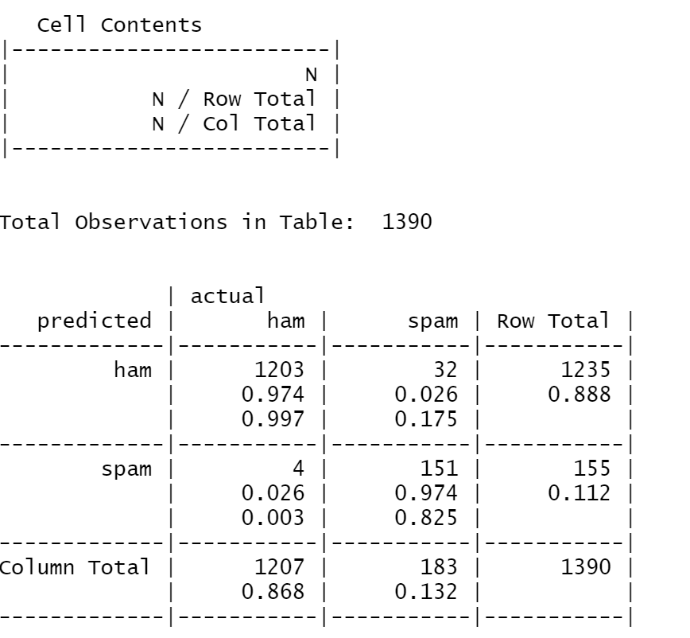
Mobile phone spam filter: evaluating model performance (cont.)

Slide 90
Mobile phone spam filter: evaluating model performance (cont.)
The crosstab shows that the Bayes classifier made 36 mistakes, corresponding to an error rate of 2,6%. Out of these 36 mistakes, 4 are false positives (a ham message is predicted as spam) and 32 are false negatives (a spam message is predicted as ham). Different domains require a different balance between false positives and false negatives. In the cancer diagnosis domain, it could be more important to reduce false negatives than false positives because false negatives could result in an undiagnosed disease . In the spam filter domain, false positives could be more important than false negatives because false negatives could result in undelivered/lost email.

Slide 91
Mobile phone spam filter: improving model performance
We will try to improve the model by using a Laplacian correction (the model was previously built with laplace = 0 by default):
> sms_classifier2 <- naiveBayes(sms_train, sms_train_labels,laplace = 1)
After building the new model, we will use it to make predictions:
> sms_test_pred2 <- predict(sms_classifier2, sms_test)
Finally, we will compare the actual with predicted classes using a crosstab:
> CrossTable(sms_test_pred2, sms_test_labels,
prop.chisq = FALSE, prop.t = FALSE, prop.r = FALSE,
dnn = c('predicted', 'actual’))
We have 3 false positives and 34 false negatives.

Slide 92
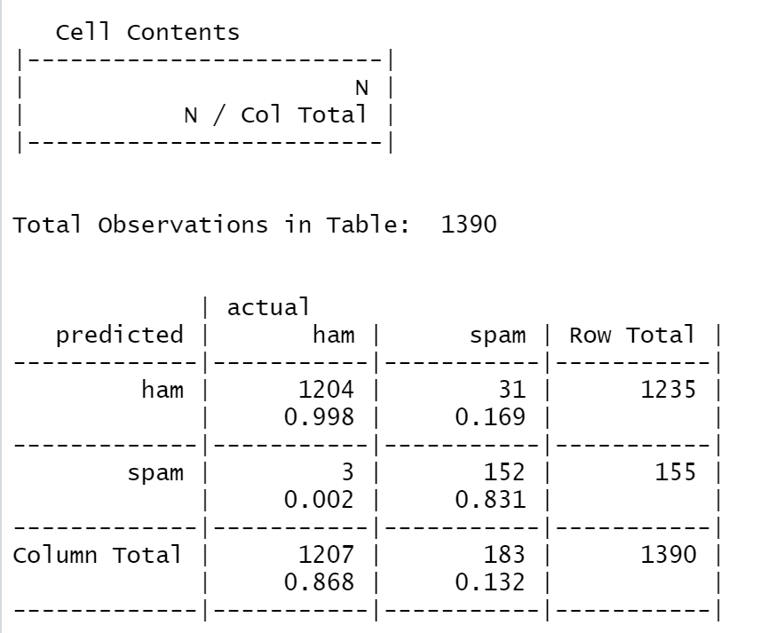
Mobile phone spam filter: improving model performance (cont.)

Slide 93
Naïve Bayes strengths and weaknesses
Strengths:
Simple, easy to implement
Can deal well with large feature spaces (due to the class-conditional independence assumption)
Fast learning
Weaknesses:
Not ideal for datasets with many numeric features
Estimated probabilities are less reliable than the predicted classes
Splits phrases into single words. For example, “Chicago bulls” will be split into “Chicago” and “Bulls”, thereby losing the meaning the phrase.
Relies on an often-faulty assumption of equally important and independent features

